Slide 1
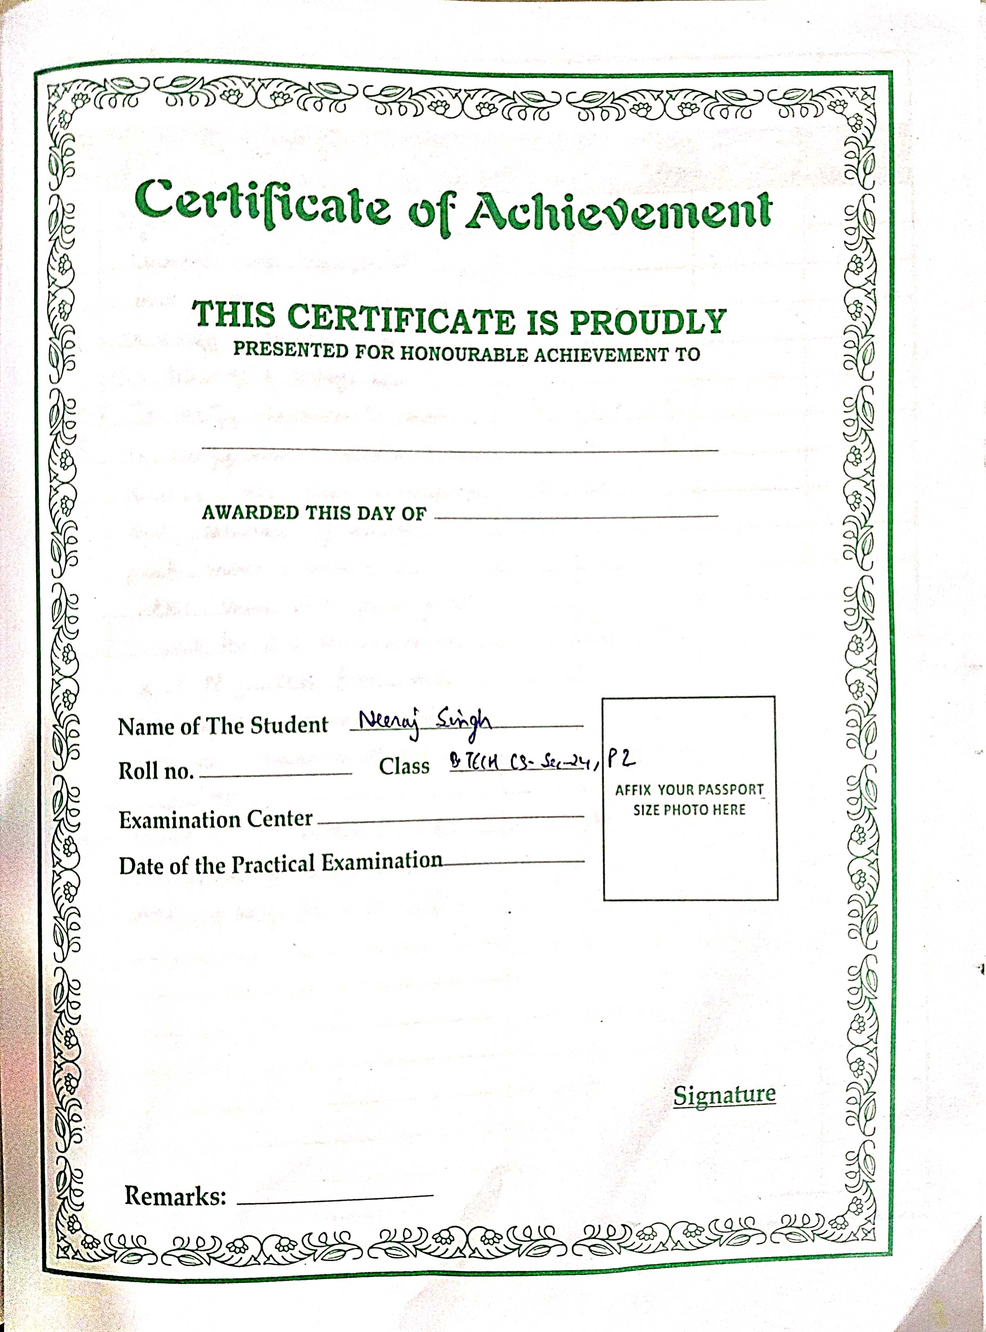
Neeraj singh p2 bee lab
Neeraj singh p2 bee lab

Slide 2
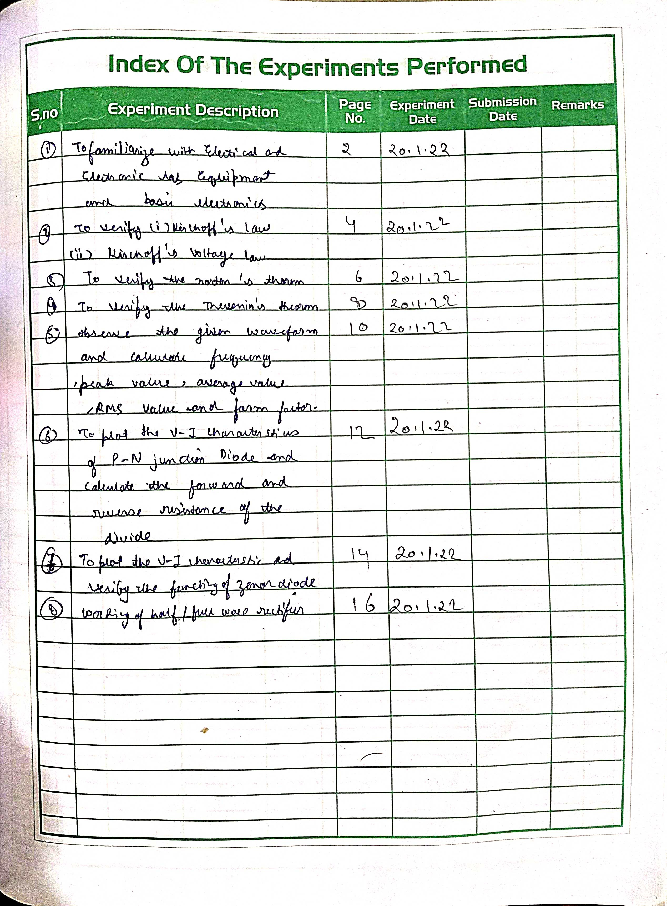
Neeraj singh p2 bee lab
Neeraj singh p2 bee lab

Slide 3
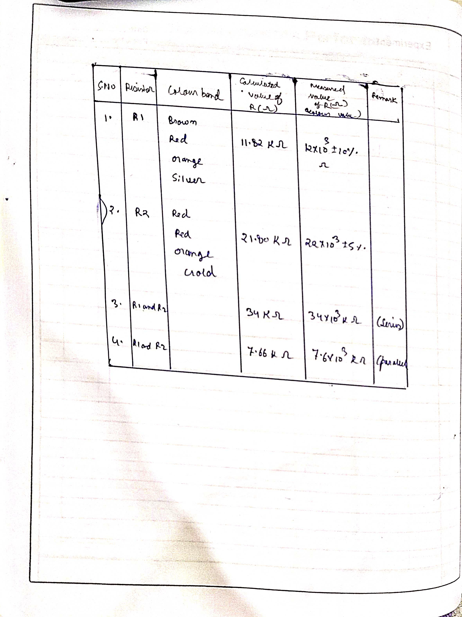
Neeraj singh p2 bee lab
Neeraj singh p2 bee lab

Slide 4
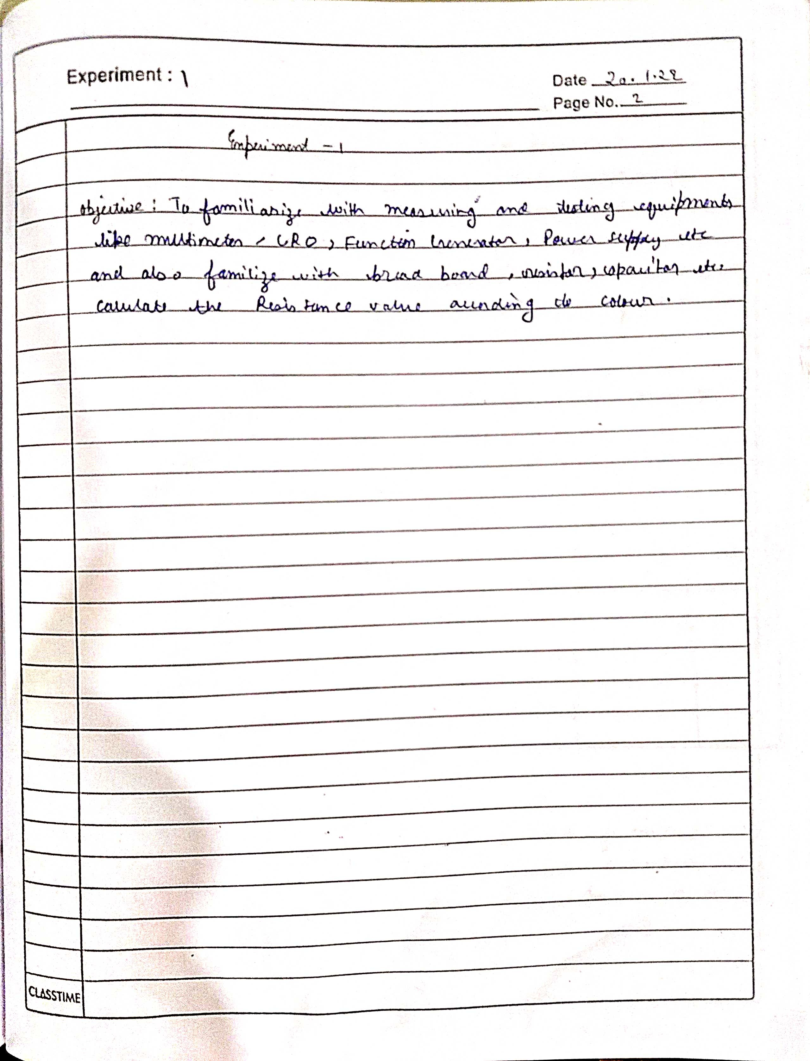
Neeraj singh p2 bee lab

Slide 5
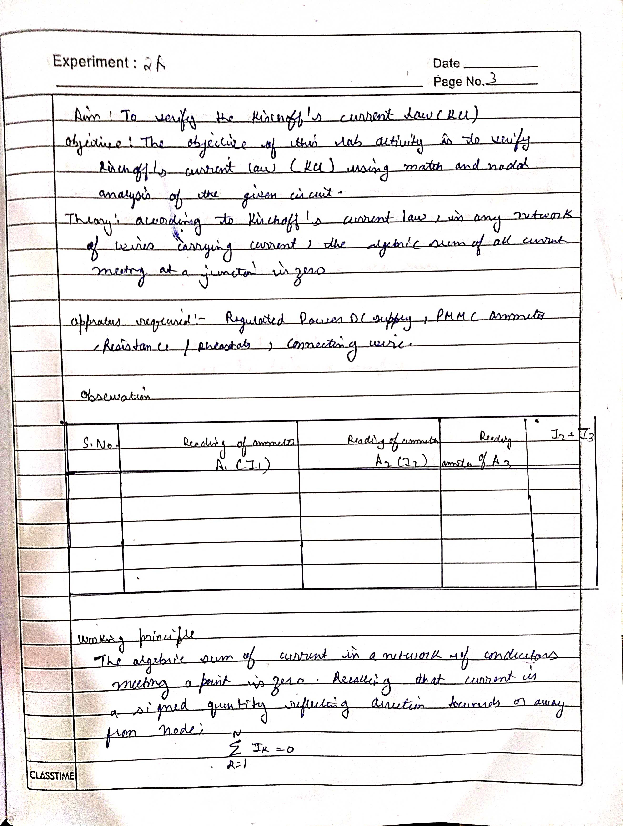
Neeraj singh p2 bee lab

Slide 6
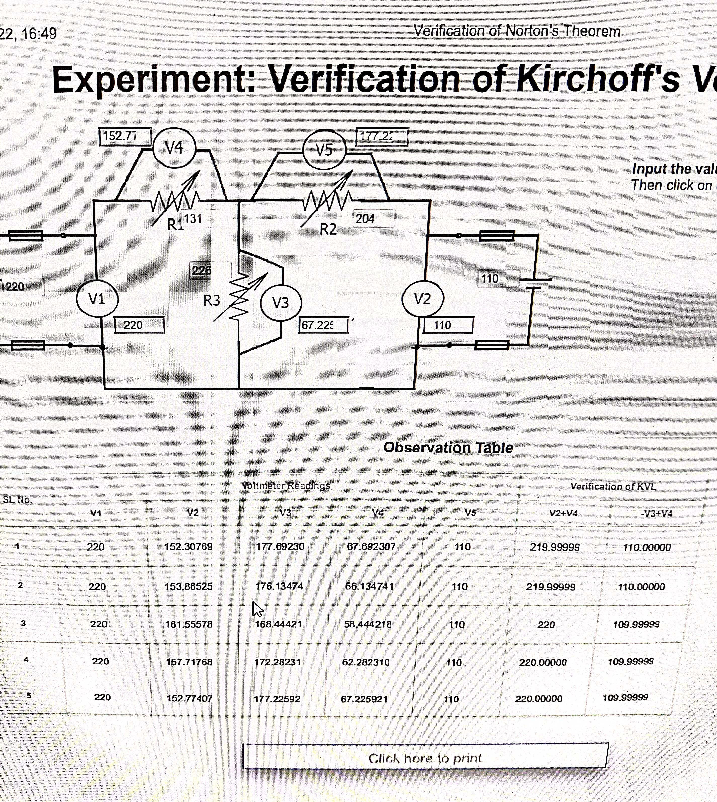
Neeraj singh p2 bee lab

Slide 7
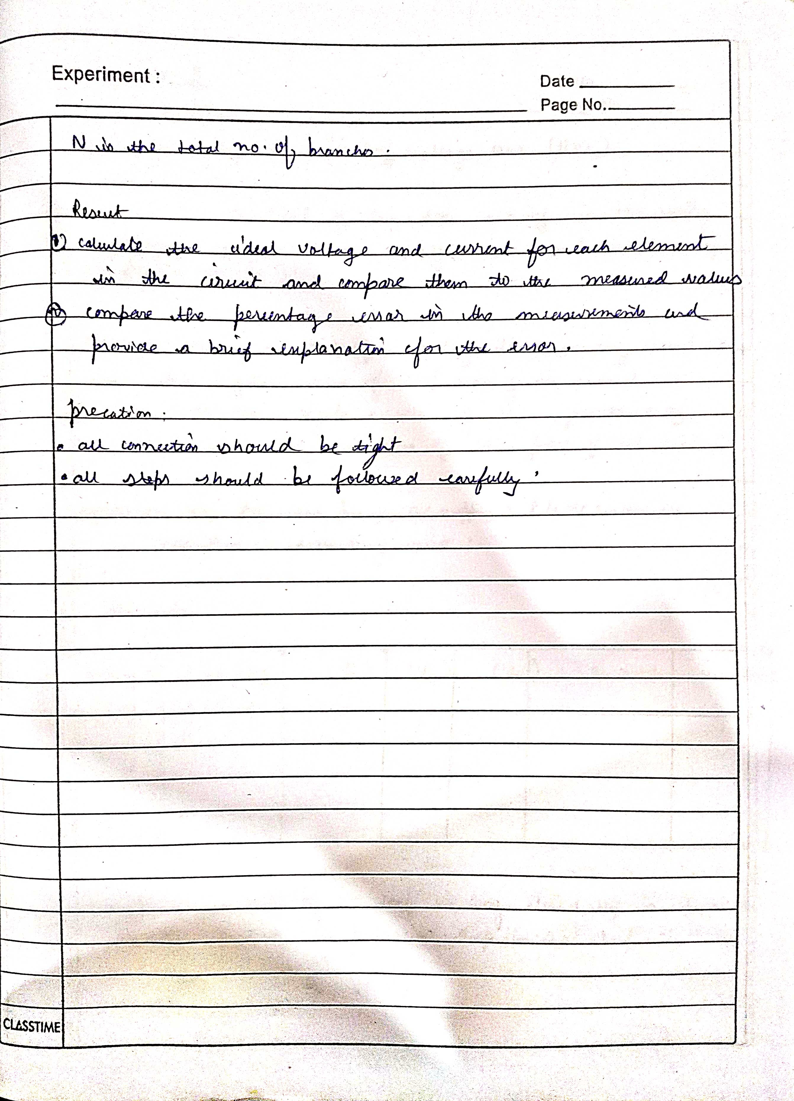
Neeraj singh p2 bee lab

Slide 8
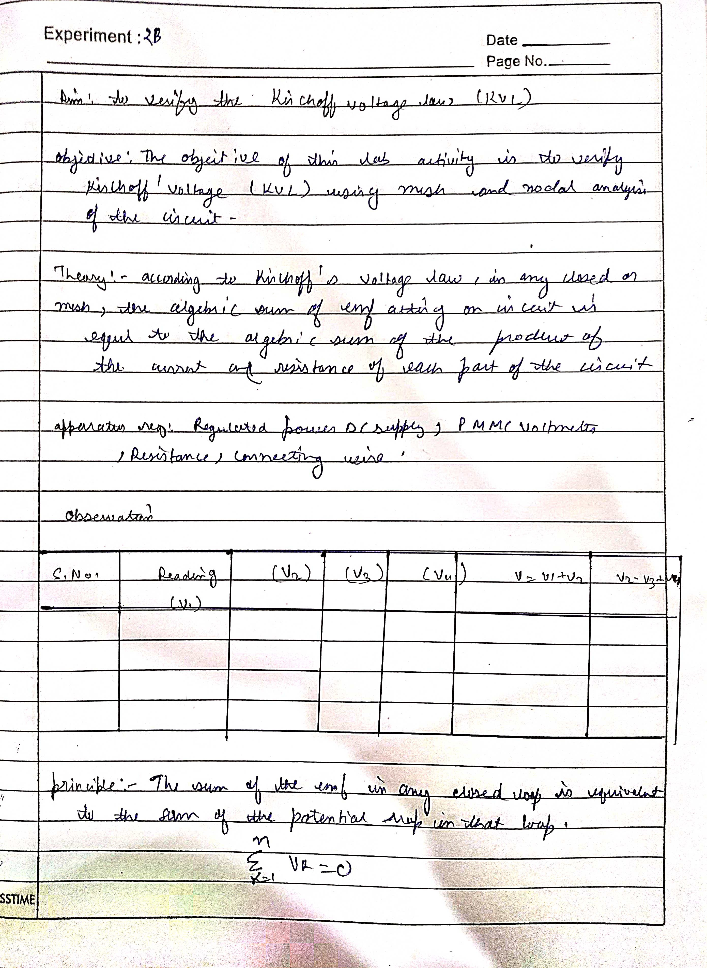
Neeraj singh p2 bee lab
Neeraj singh p2 bee lab

Slide 9
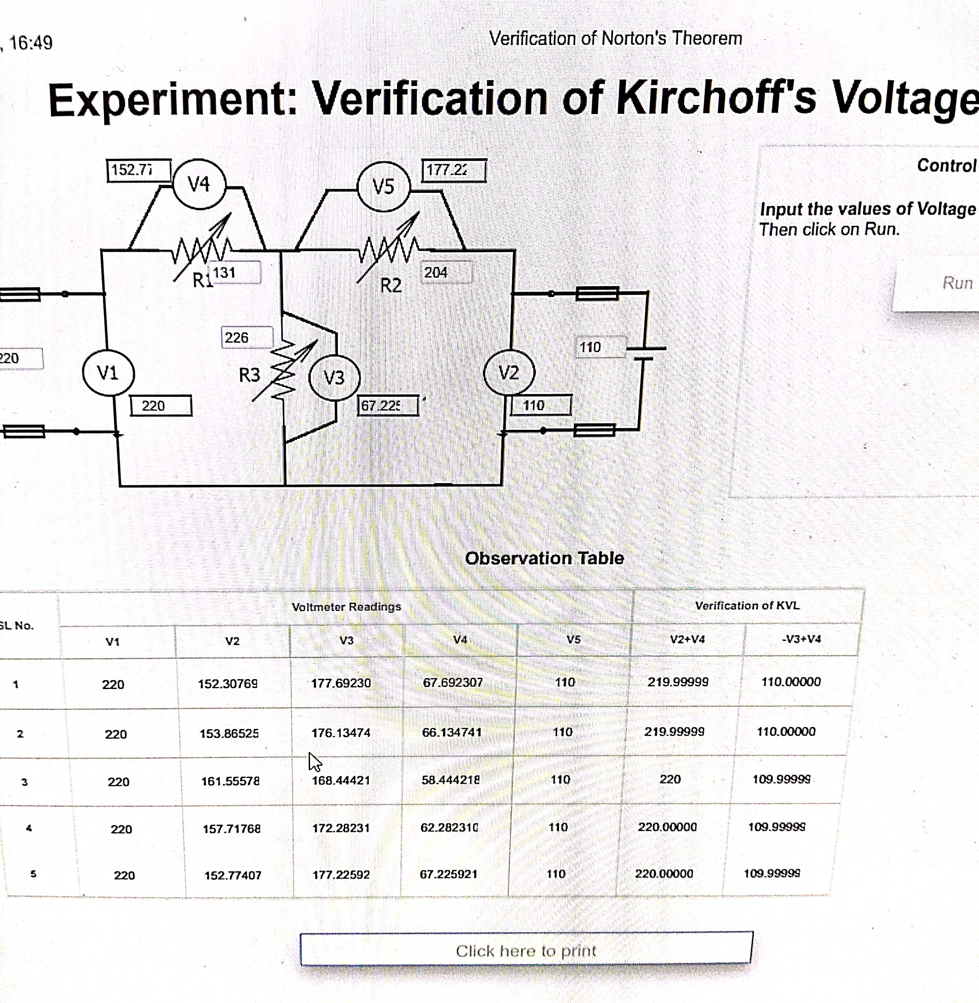
Neeraj singh p2 bee lab
Neeraj singh p2 bee lab

Slide 10
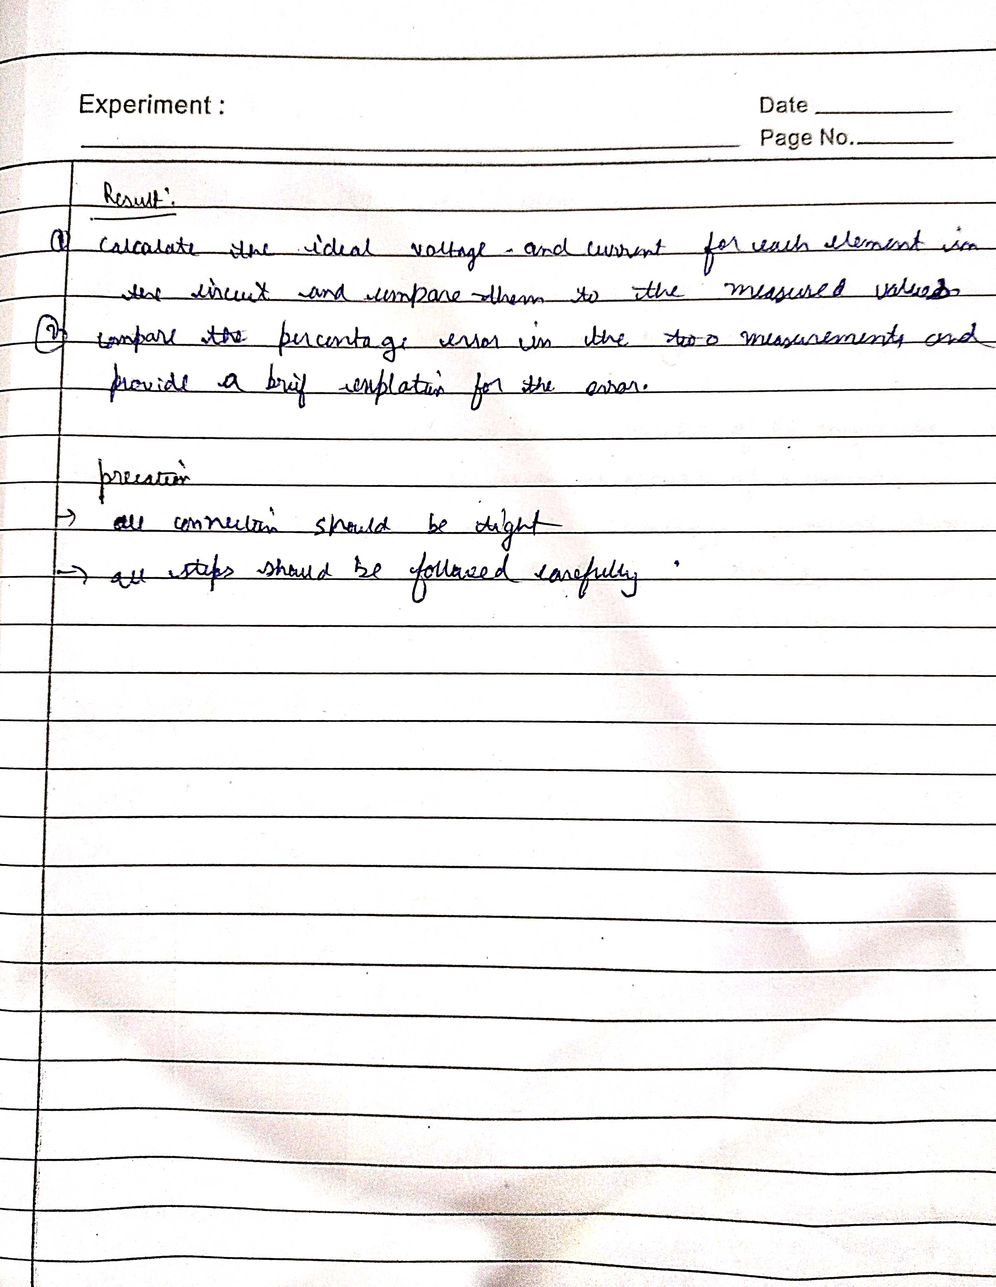
Neeraj singh p2 bee lab
Neeraj singh p2 bee lab

Slide 11
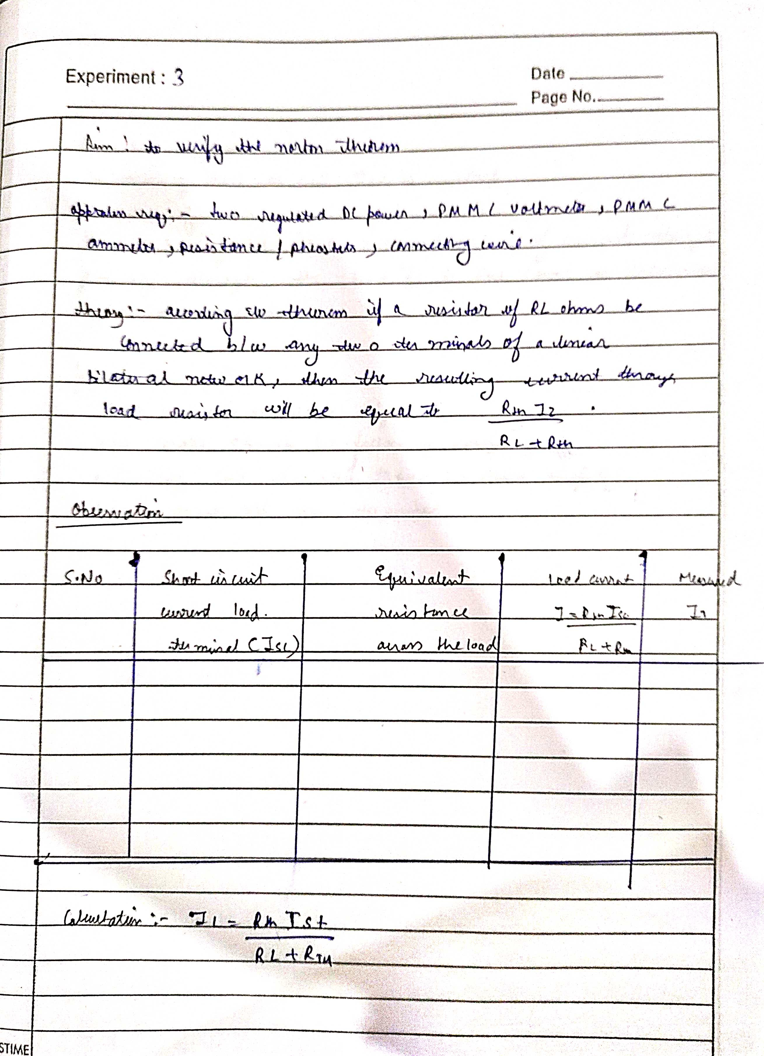

Slide 12
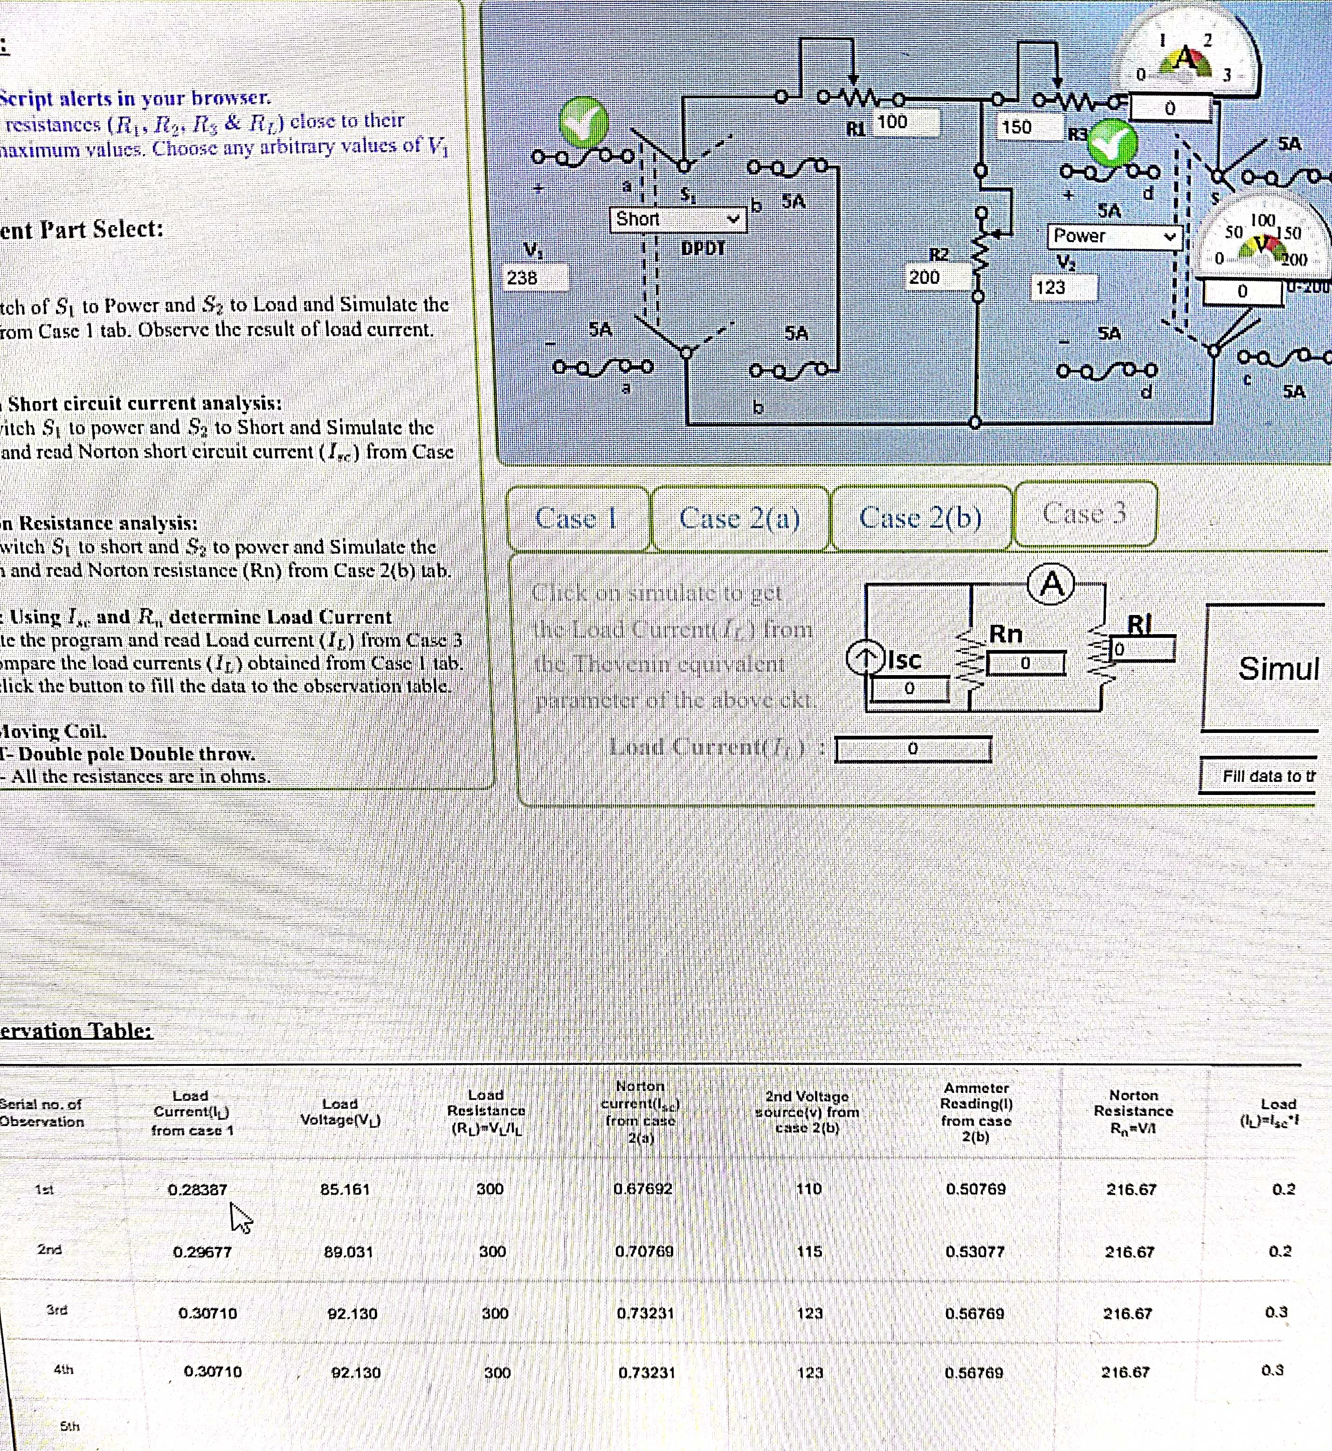
Neeraj singh p2 bee lab
Neeraj singh p2 bee lab

Slide 13
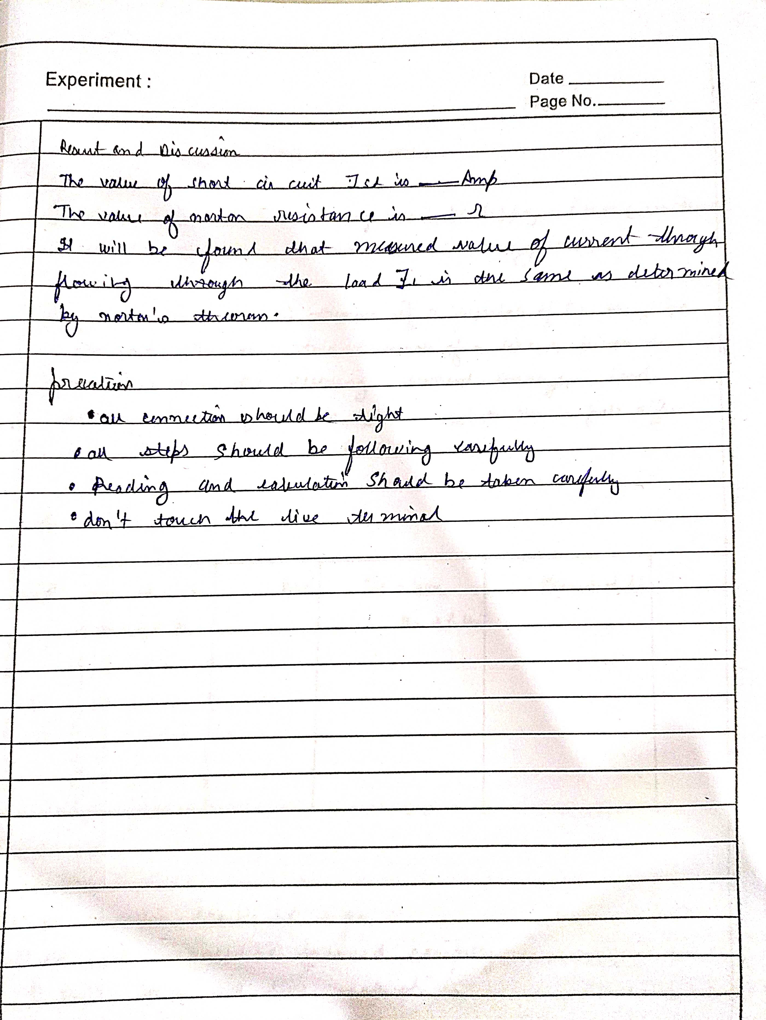
Neeraj singh p2 bee lab
Neeraj singh p2 bee lab

Slide 14
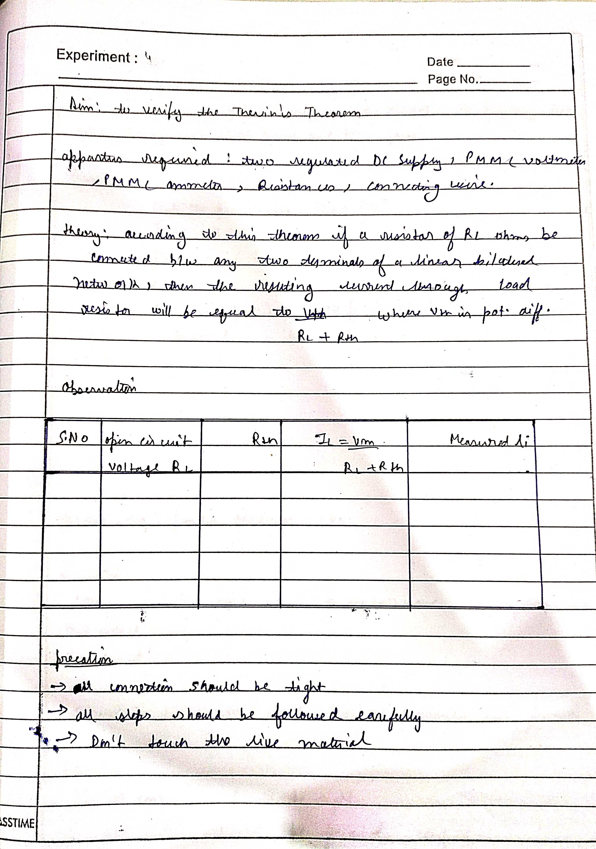

Slide 15
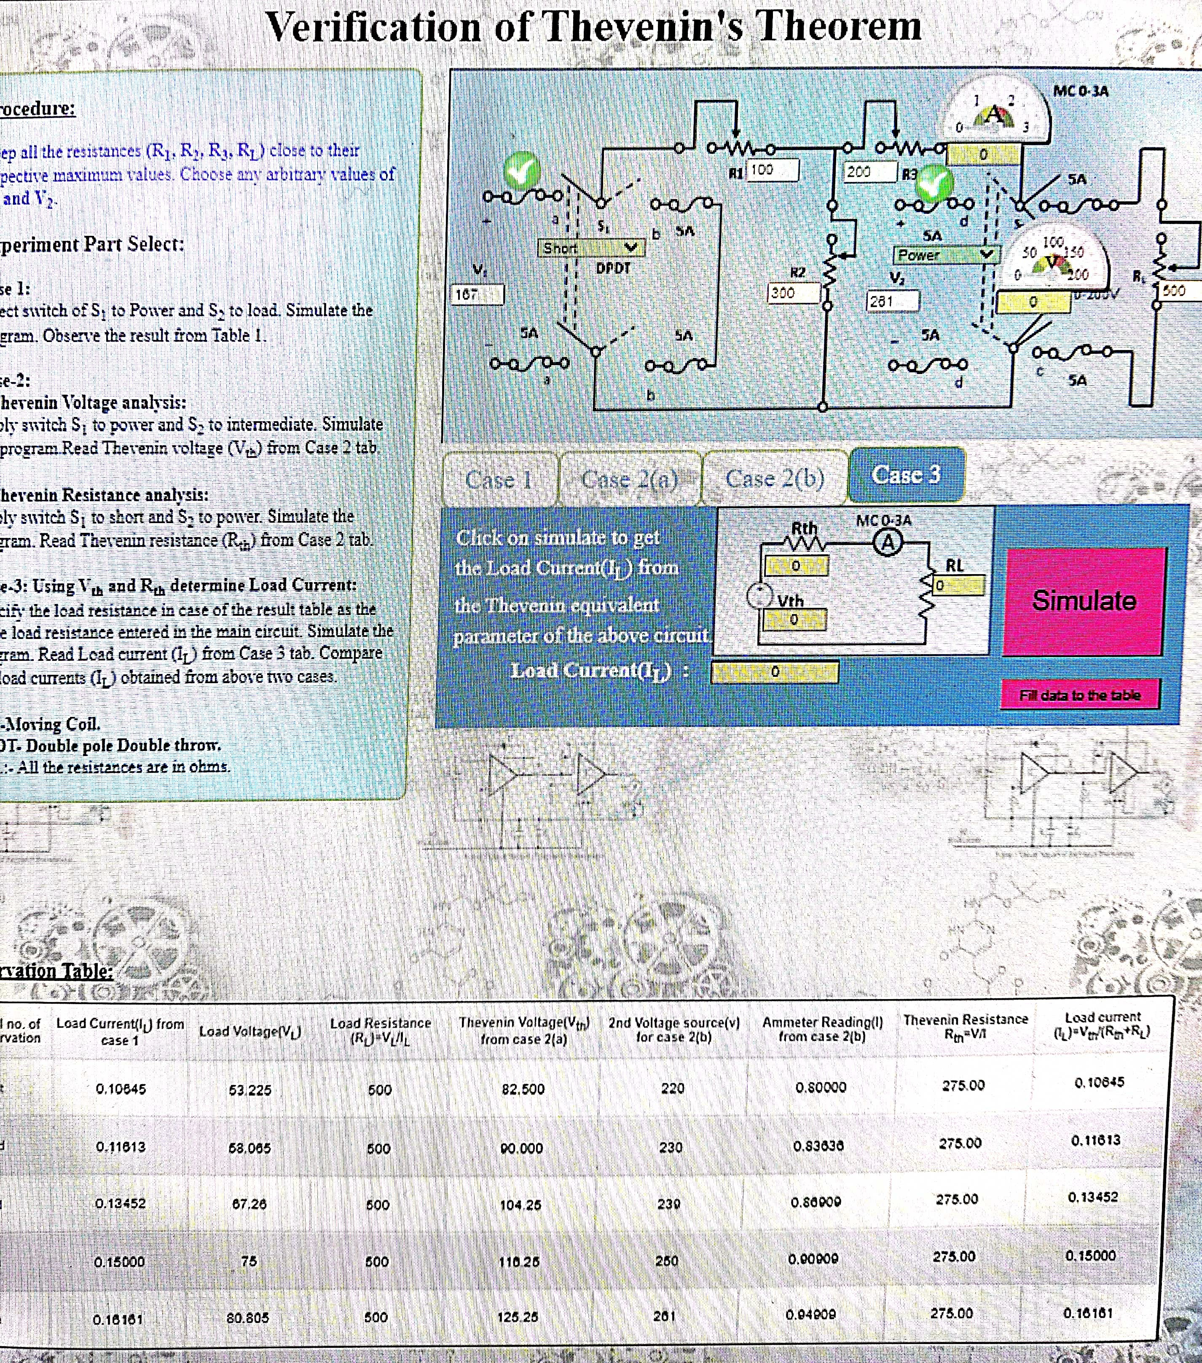
Neeraj singh p2 bee lab

Slide 16
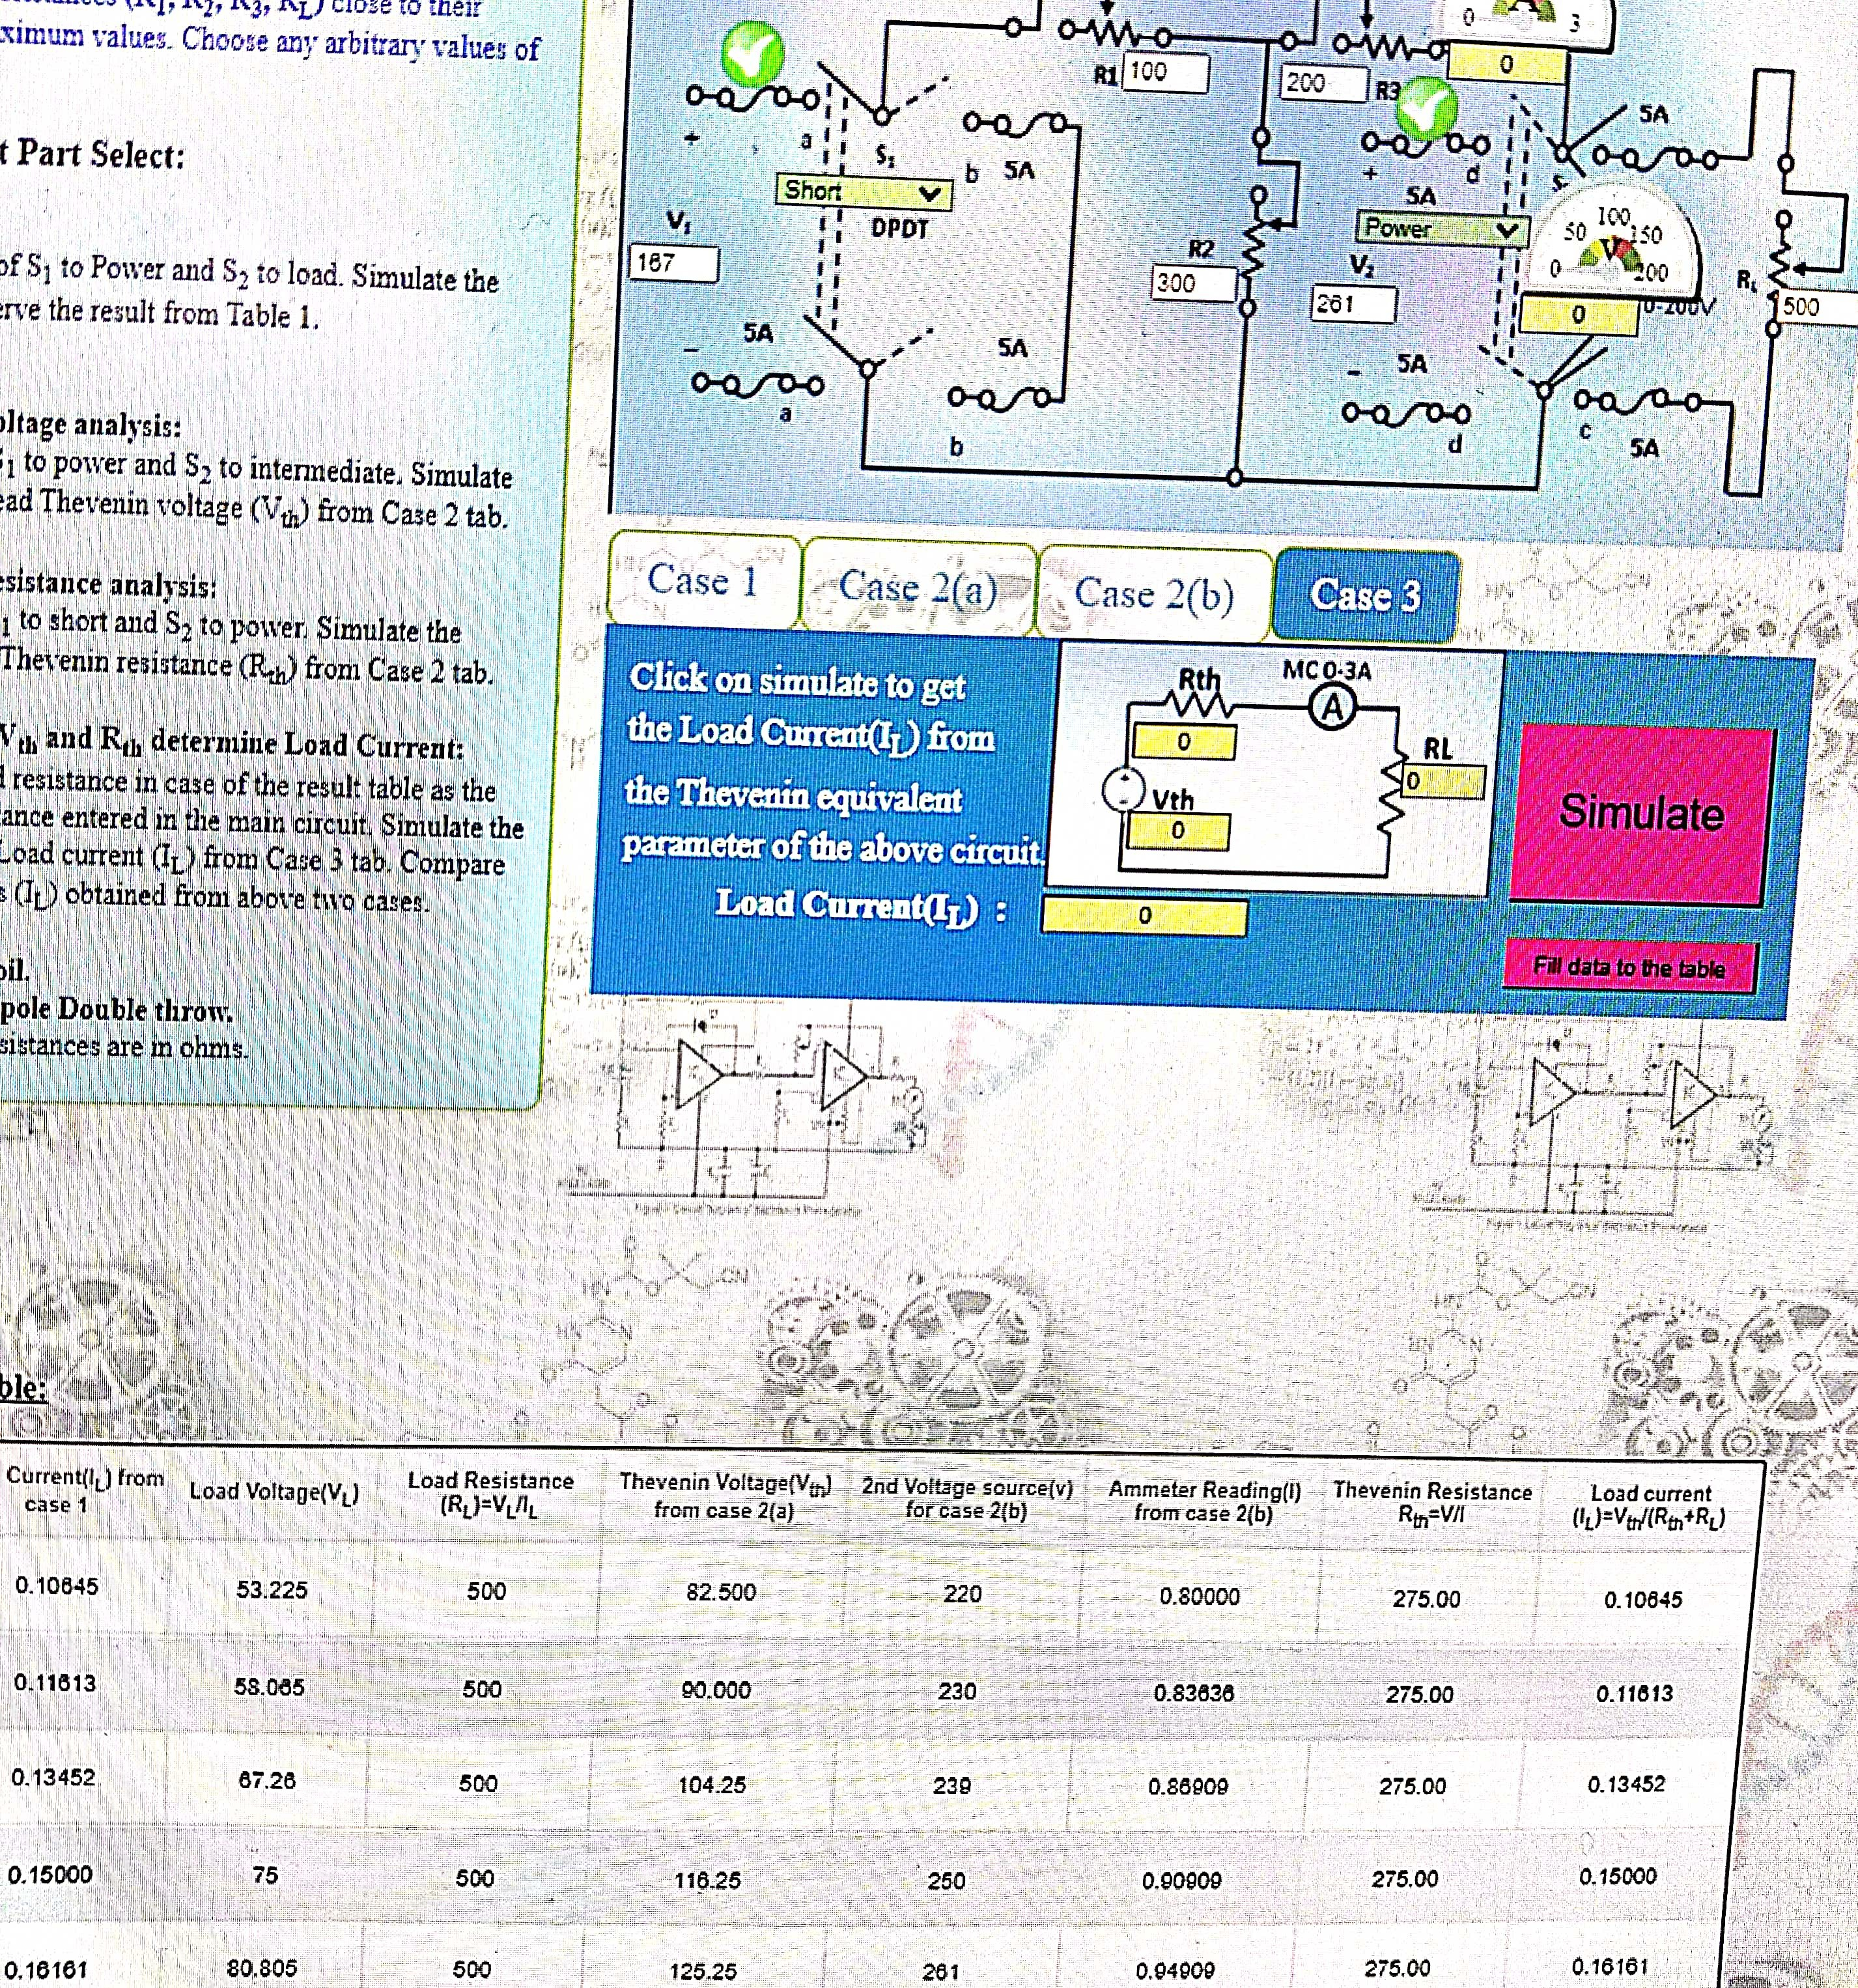
Neeraj singh p2 bee lab
Neeraj singh p2 bee lab

Slide 17
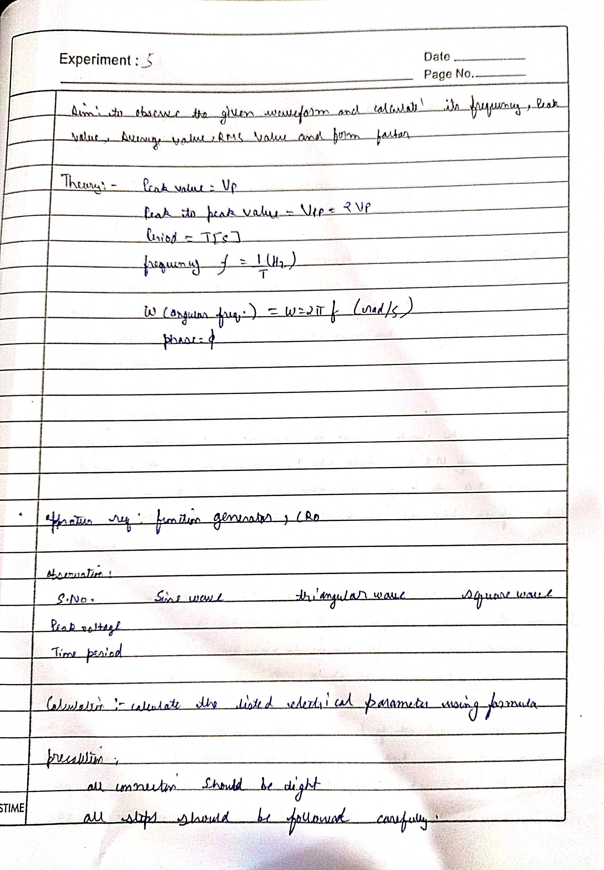
Neeraj singh p2 bee lab
Neeraj singh p2 bee lab

Slide 18
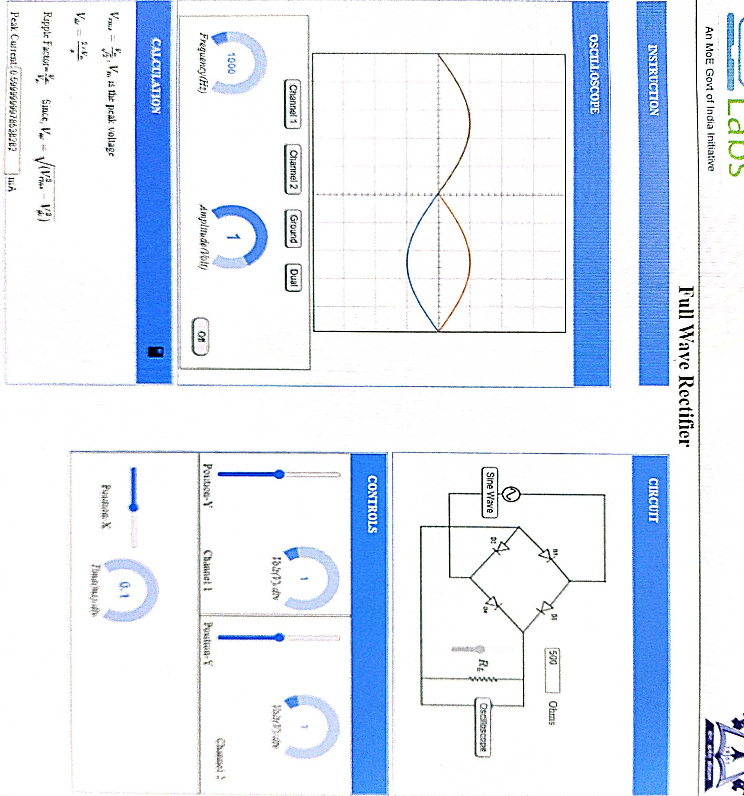
Neeraj singh p2 bee lab

Slide 19
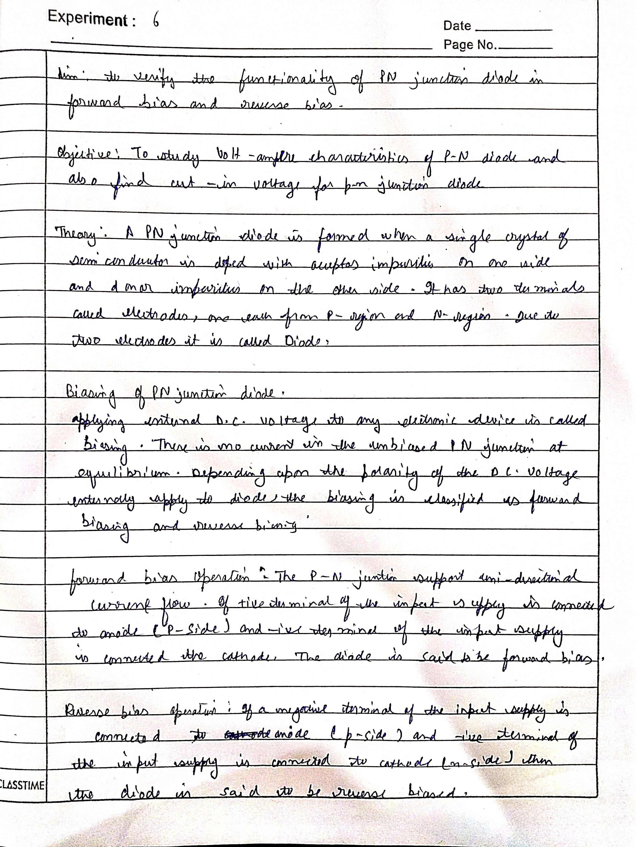
Neeraj singh p2 bee lab
Neeraj singh p2 bee lab

Slide 20
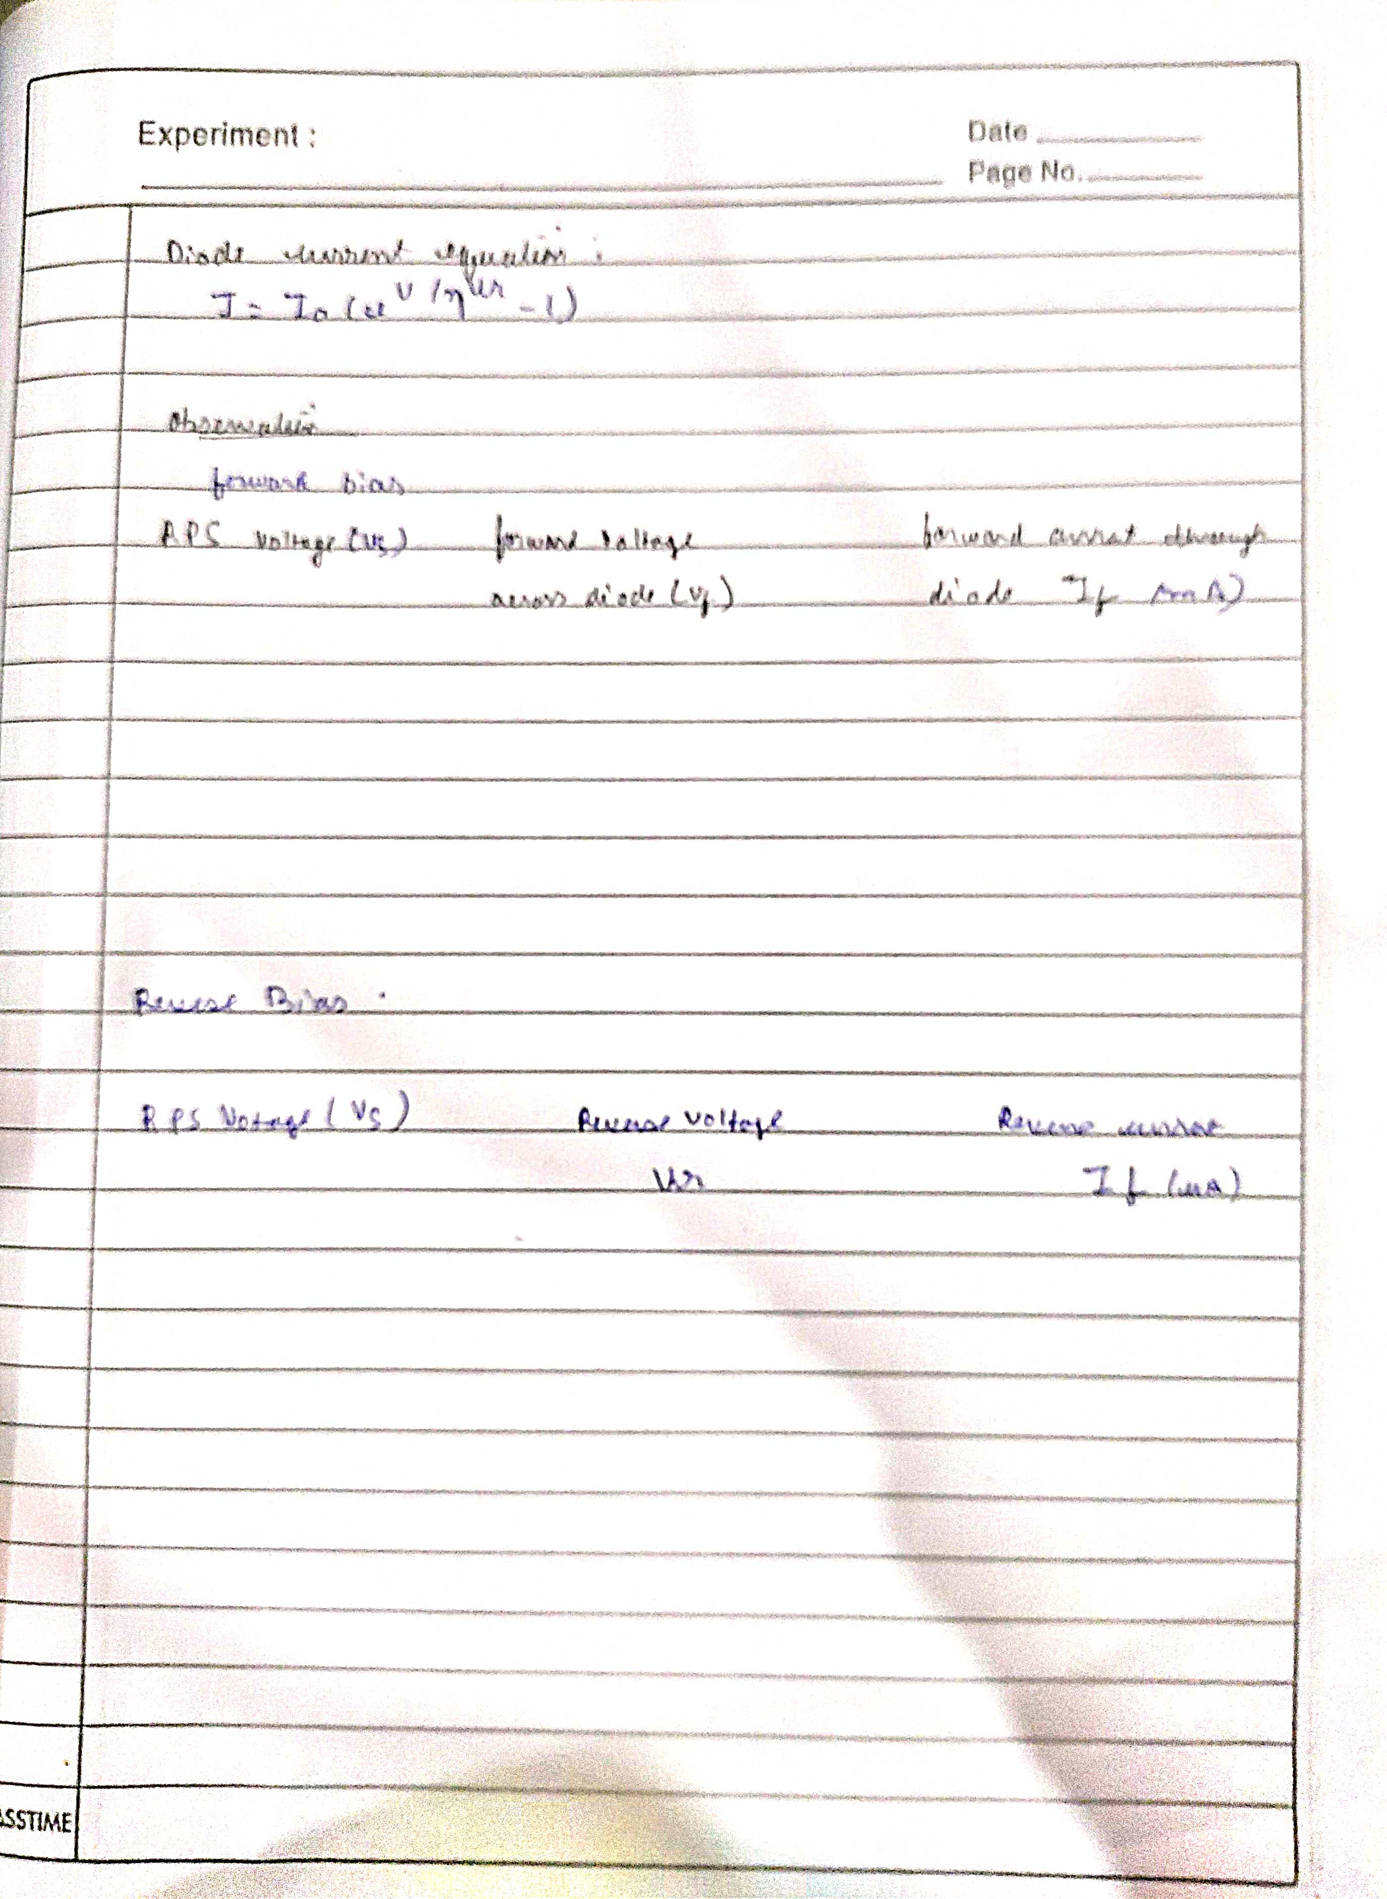
Neeraj singh p2 bee lab
Neeraj singh p2 bee lab

Slide 21
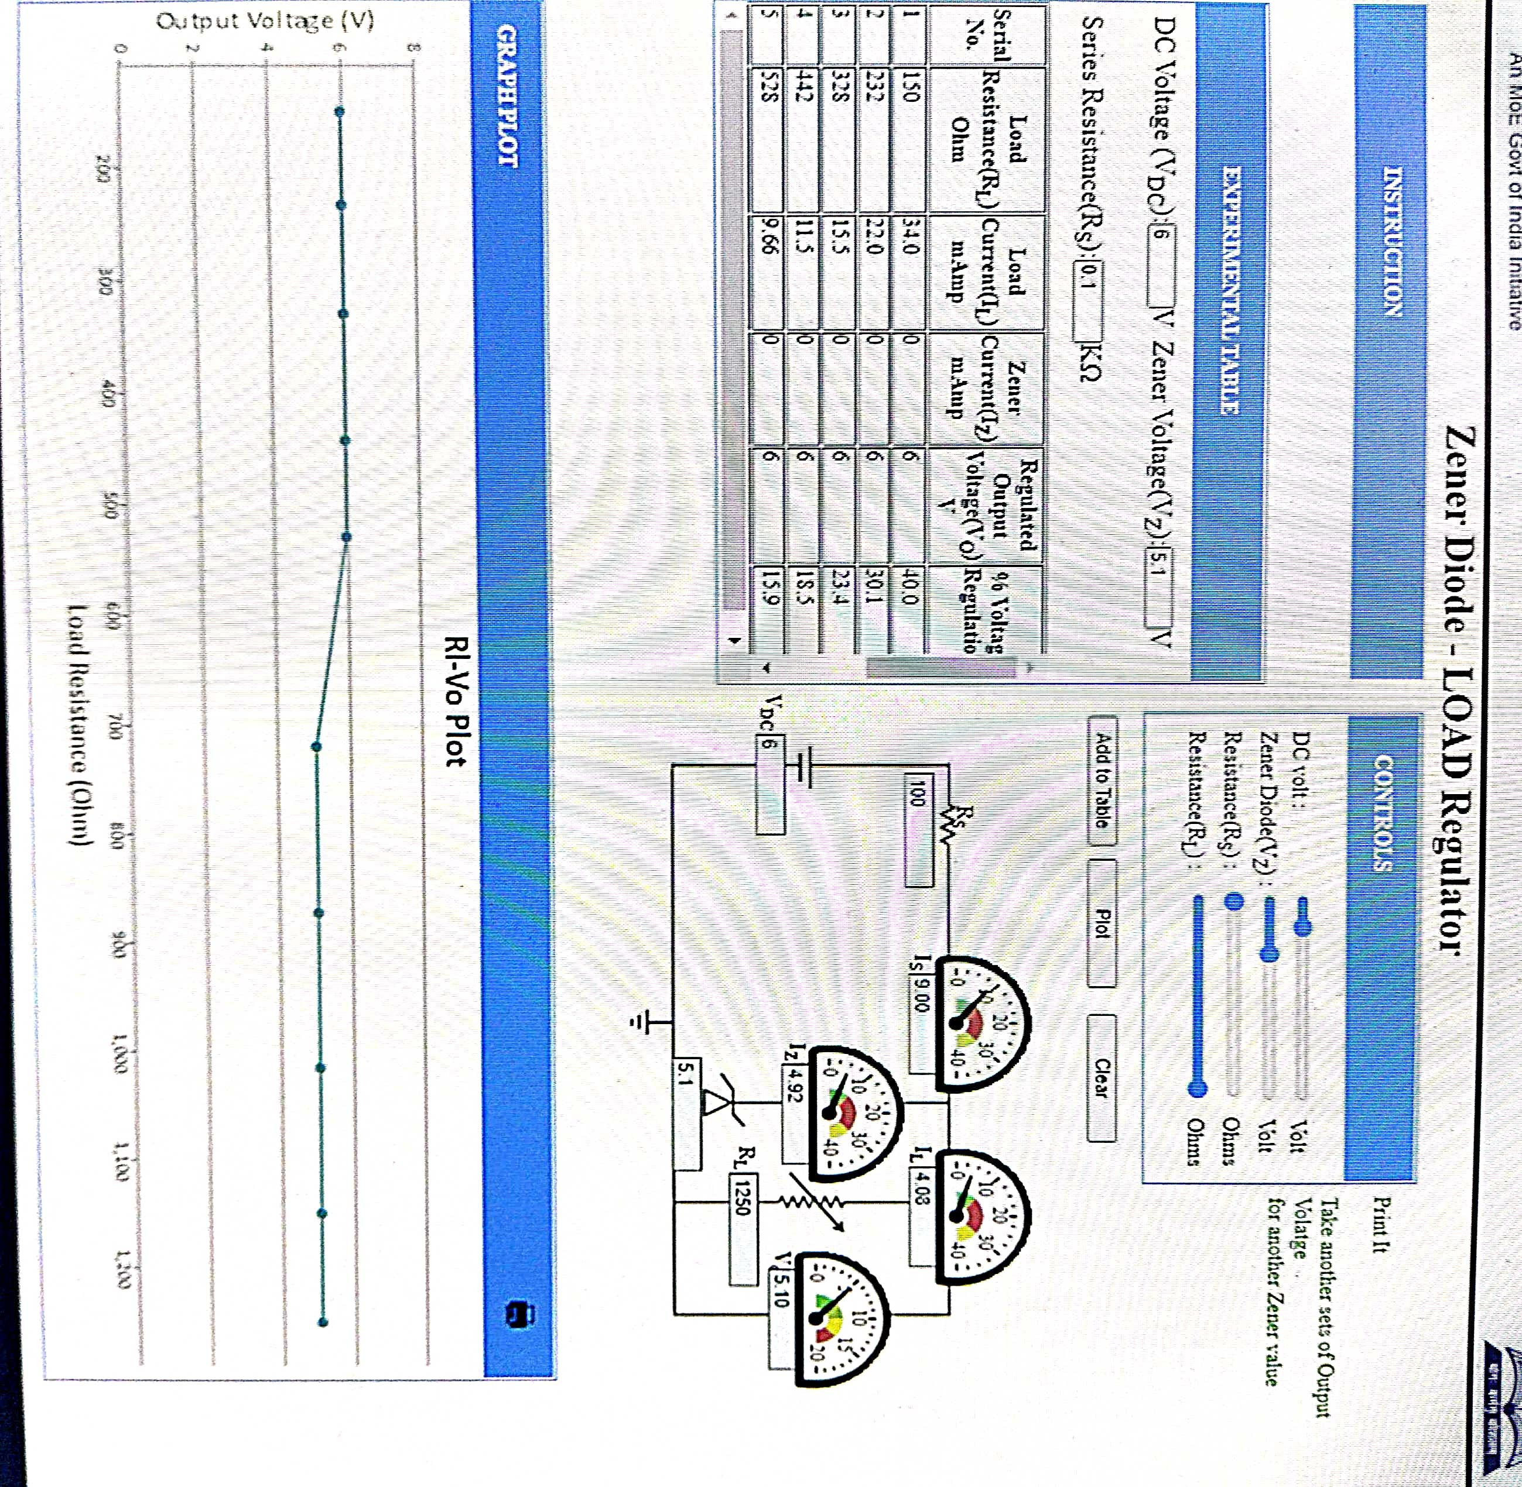
Neeraj singh p2 bee lab
Neeraj singh p2 bee lab

Slide 22
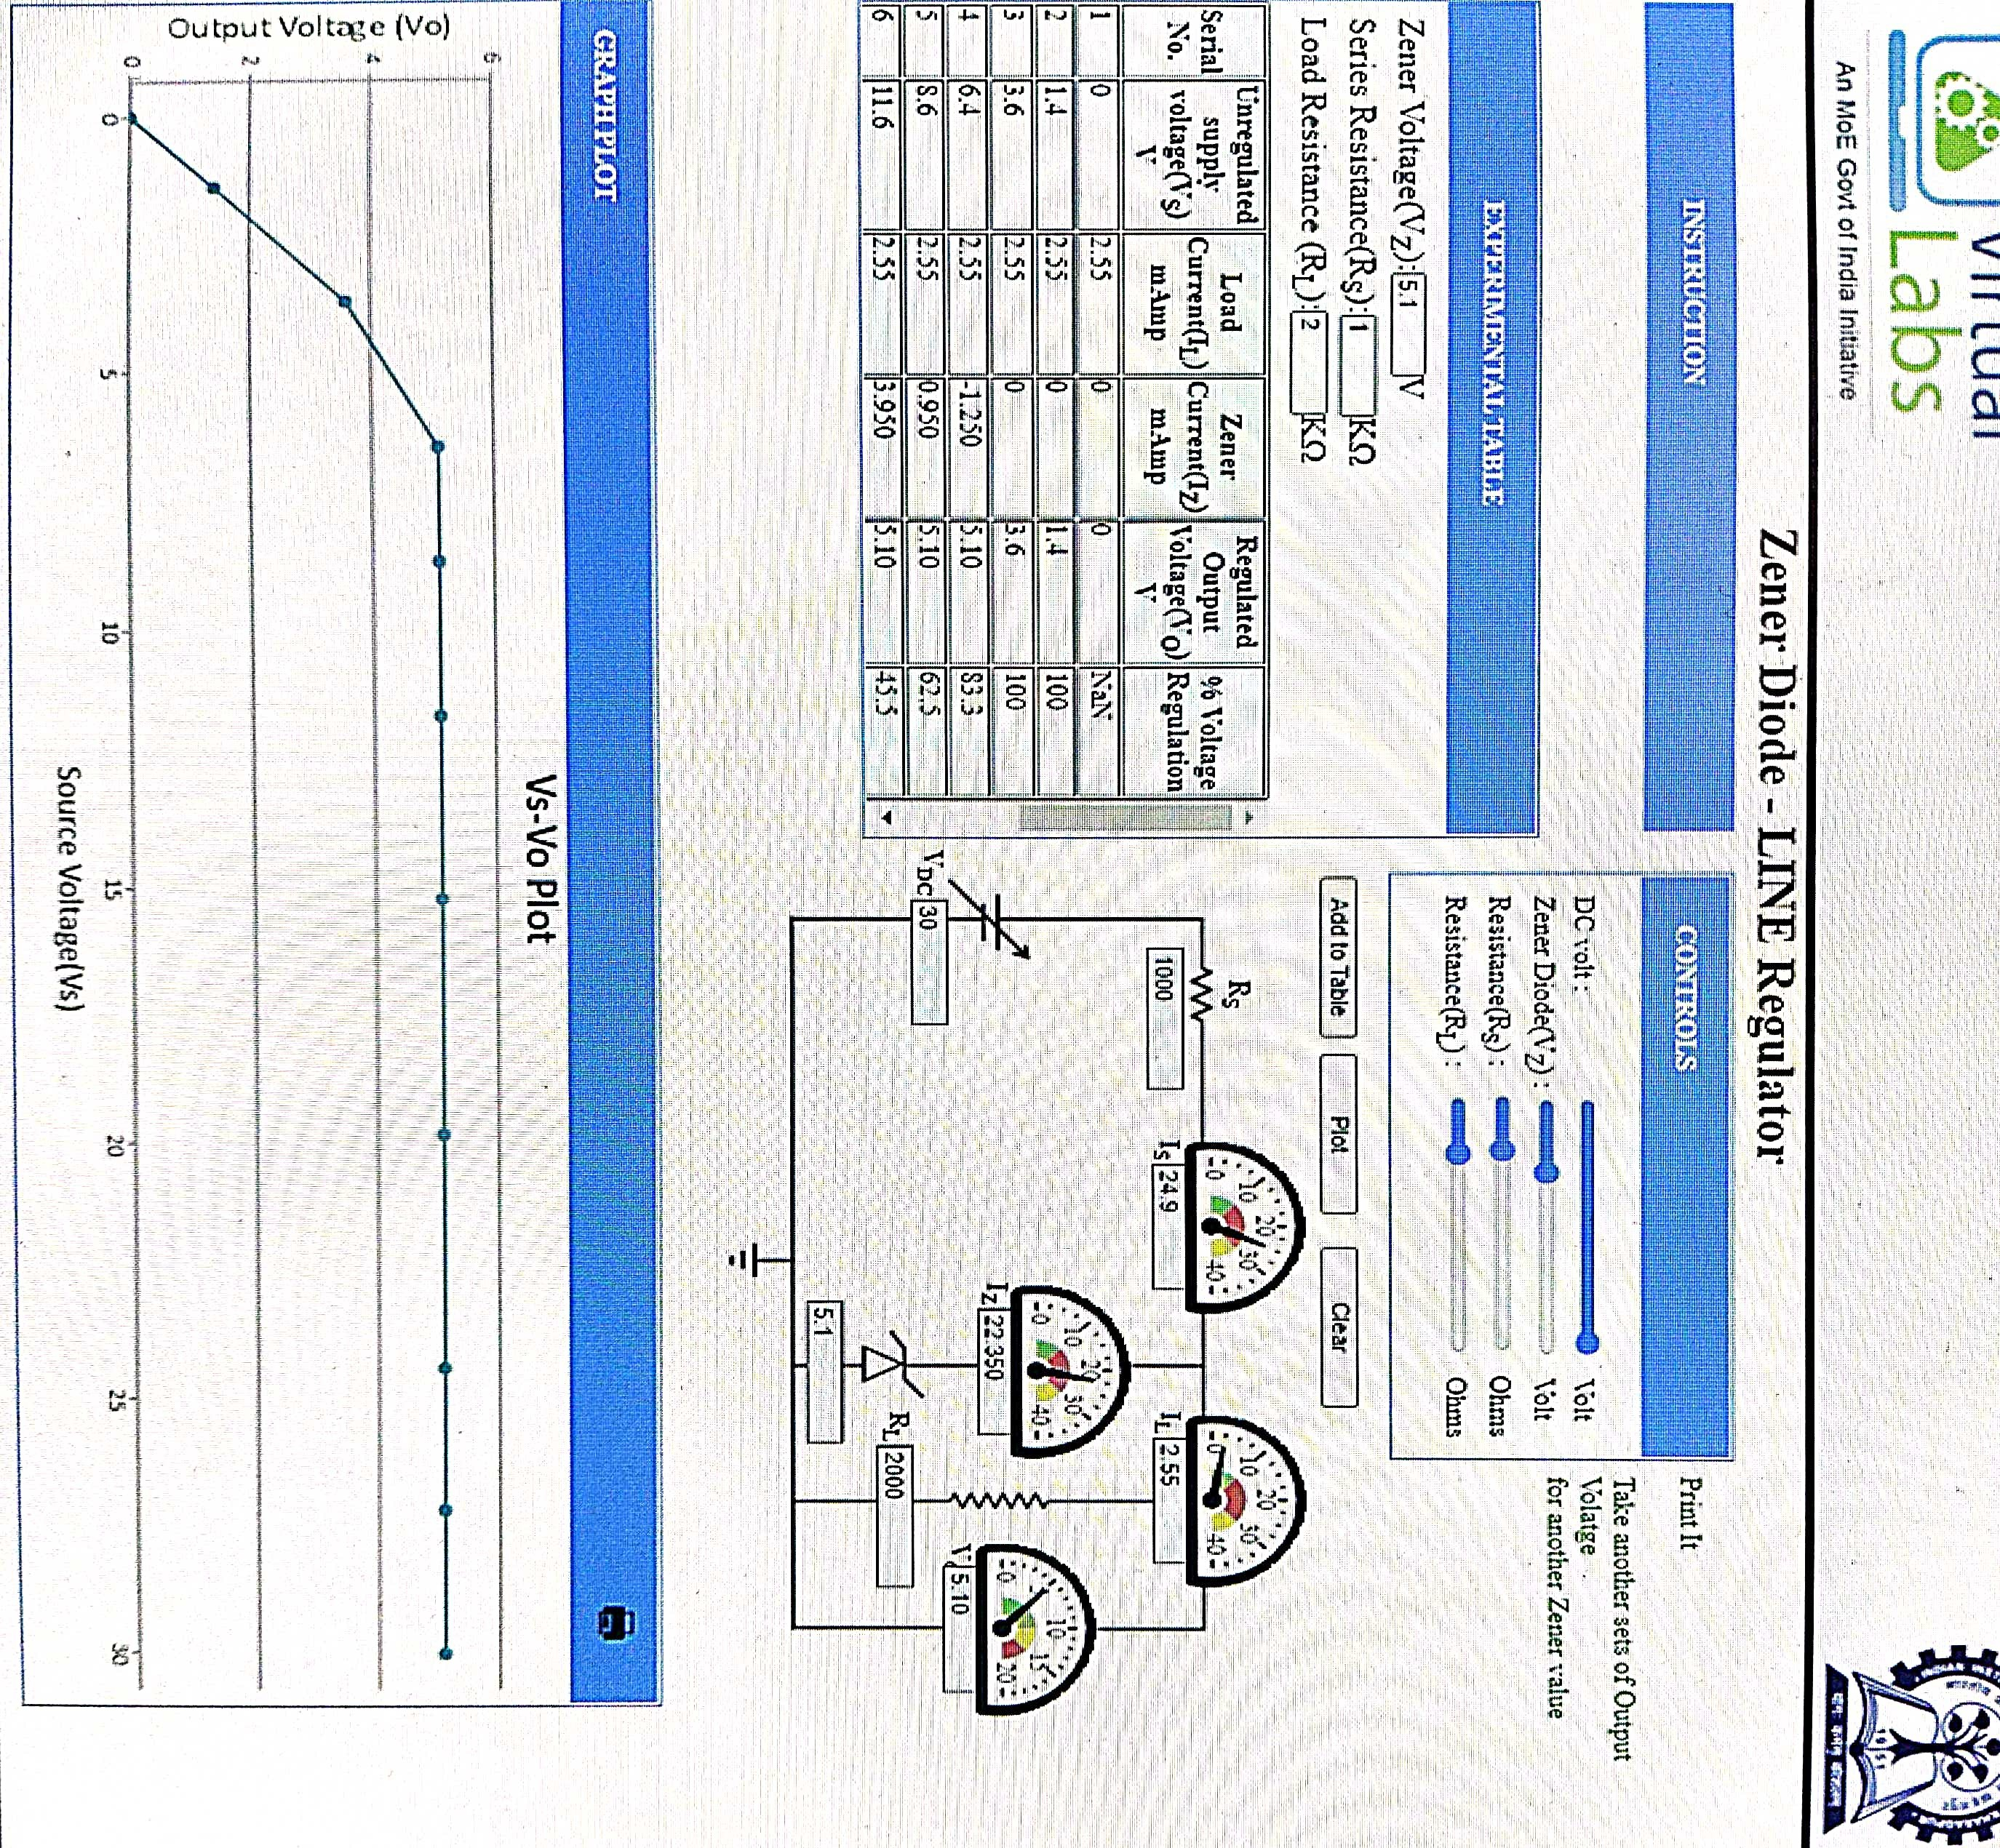
Neeraj singh p2 bee lab
Neeraj singh p2 bee lab

Slide 23
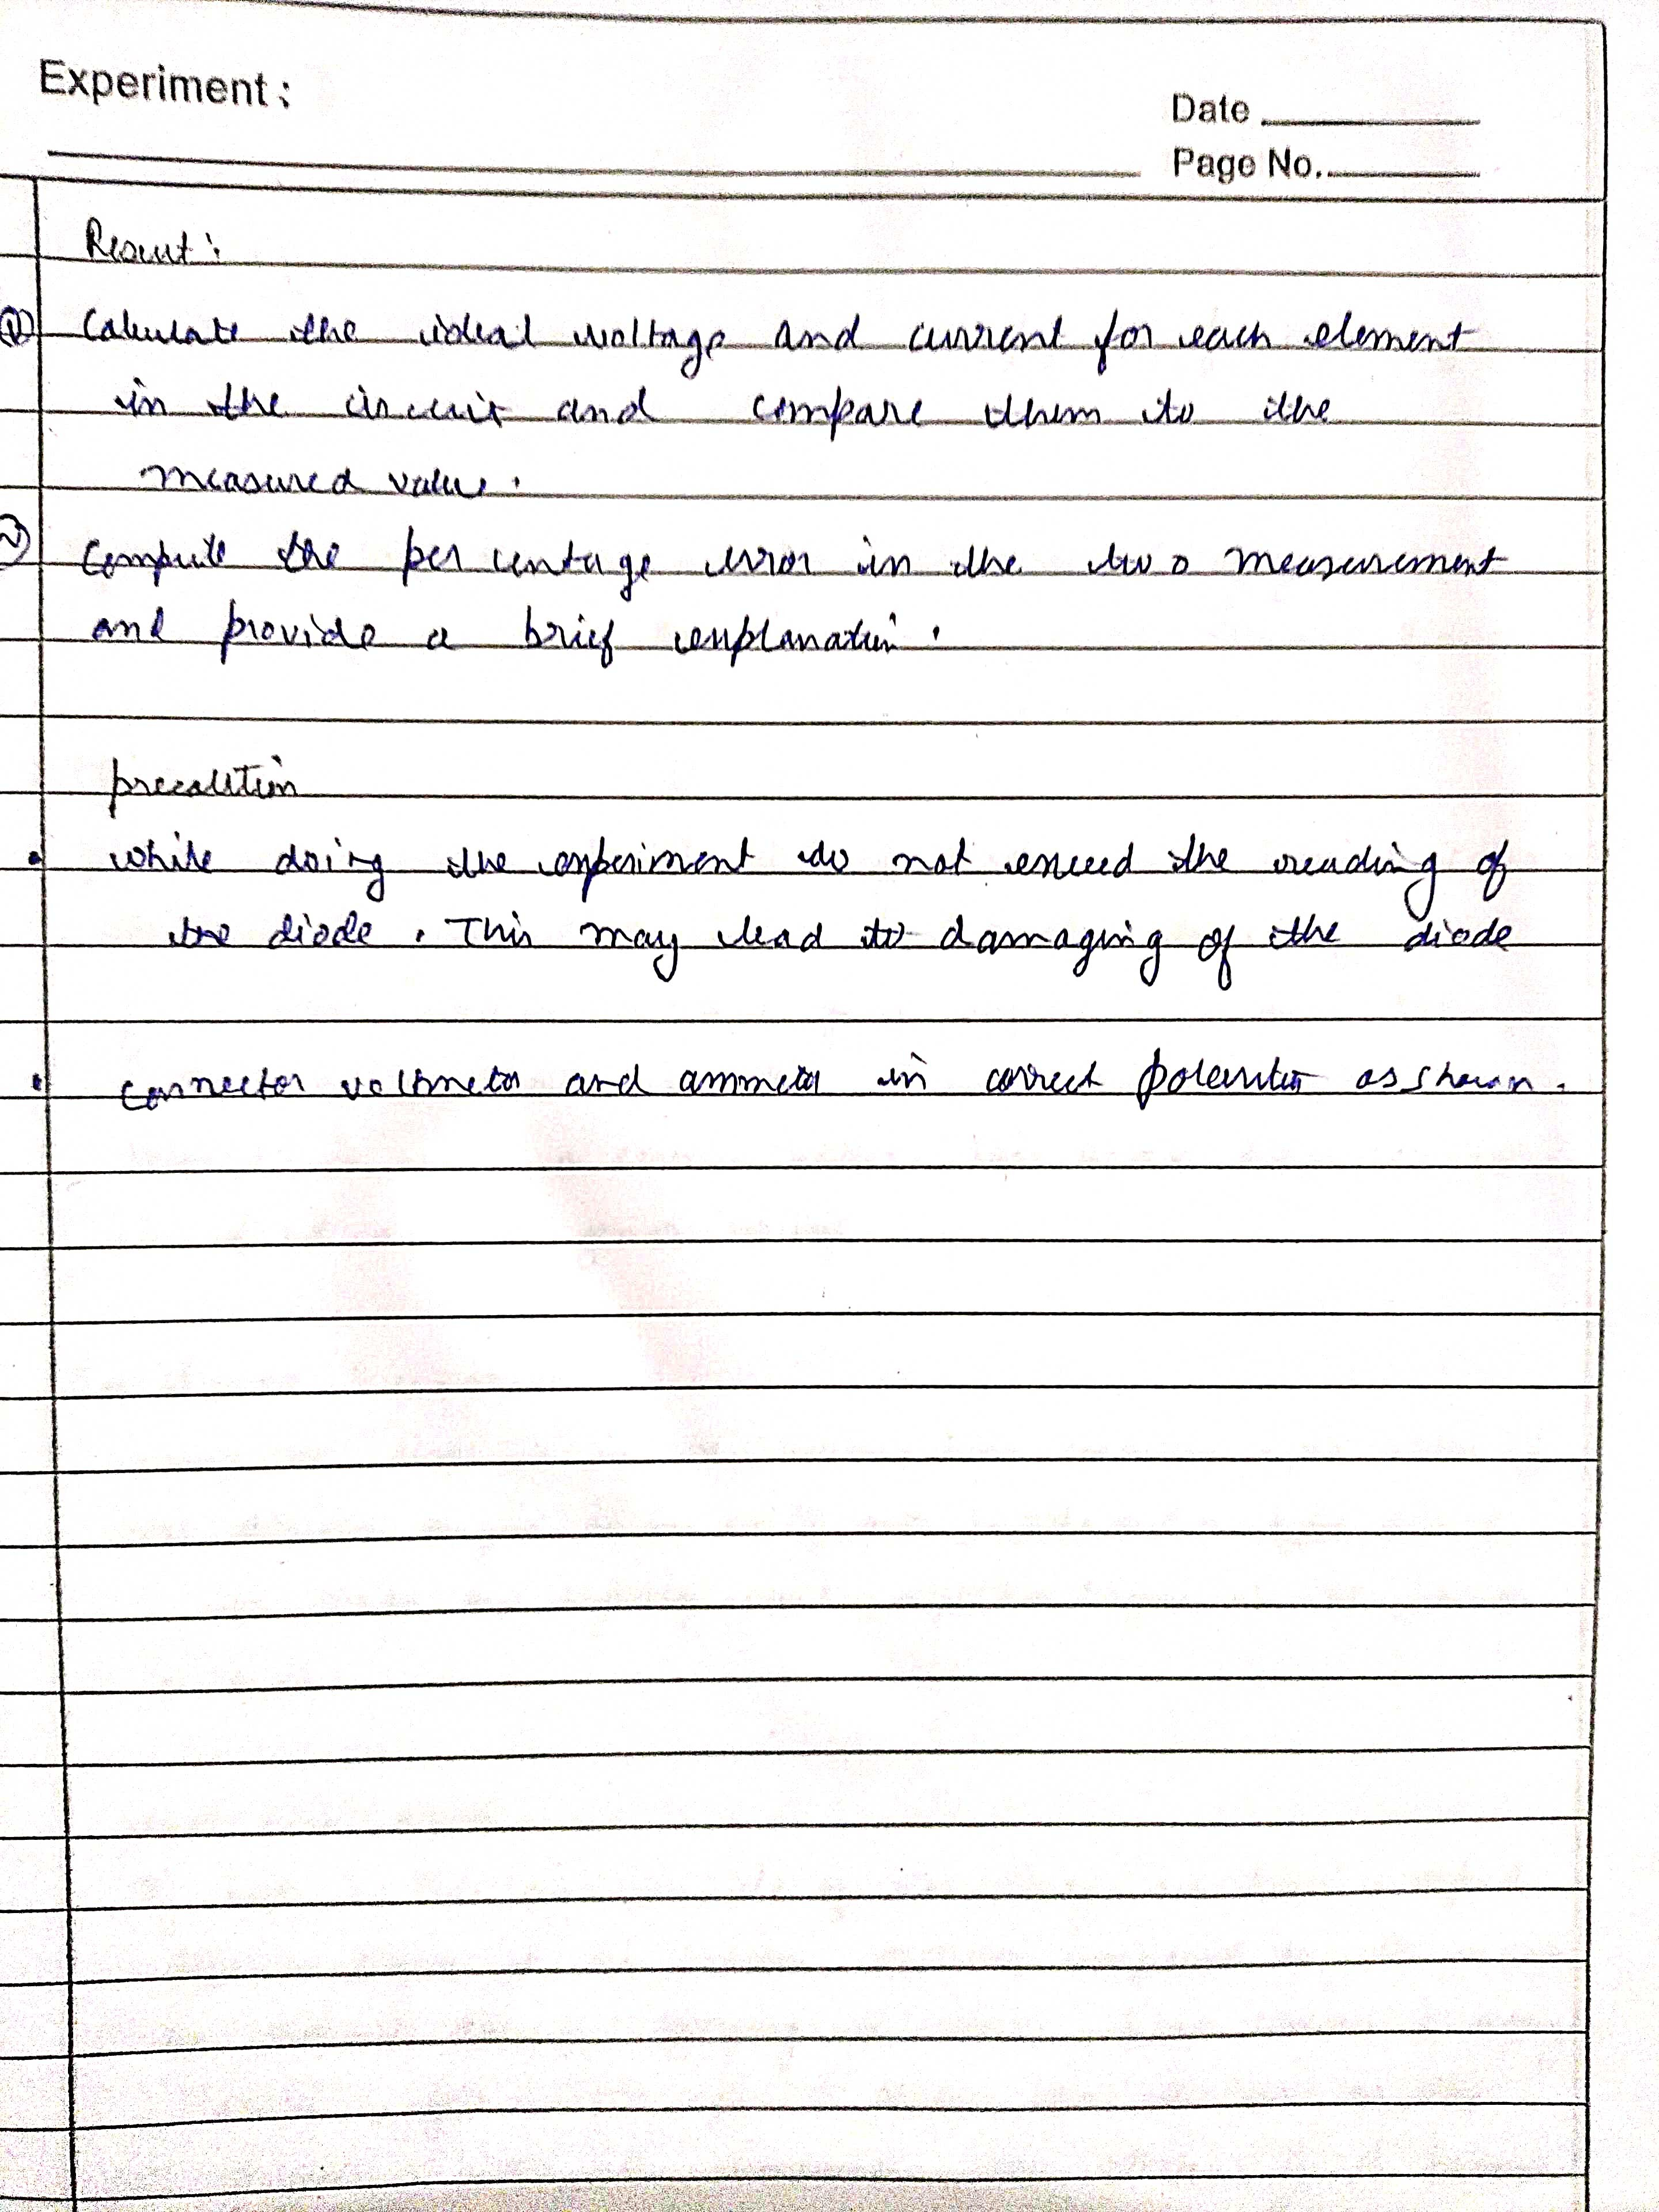
Neeraj singh p2 bee lab
Neeraj singh p2 bee lab

Slide 24
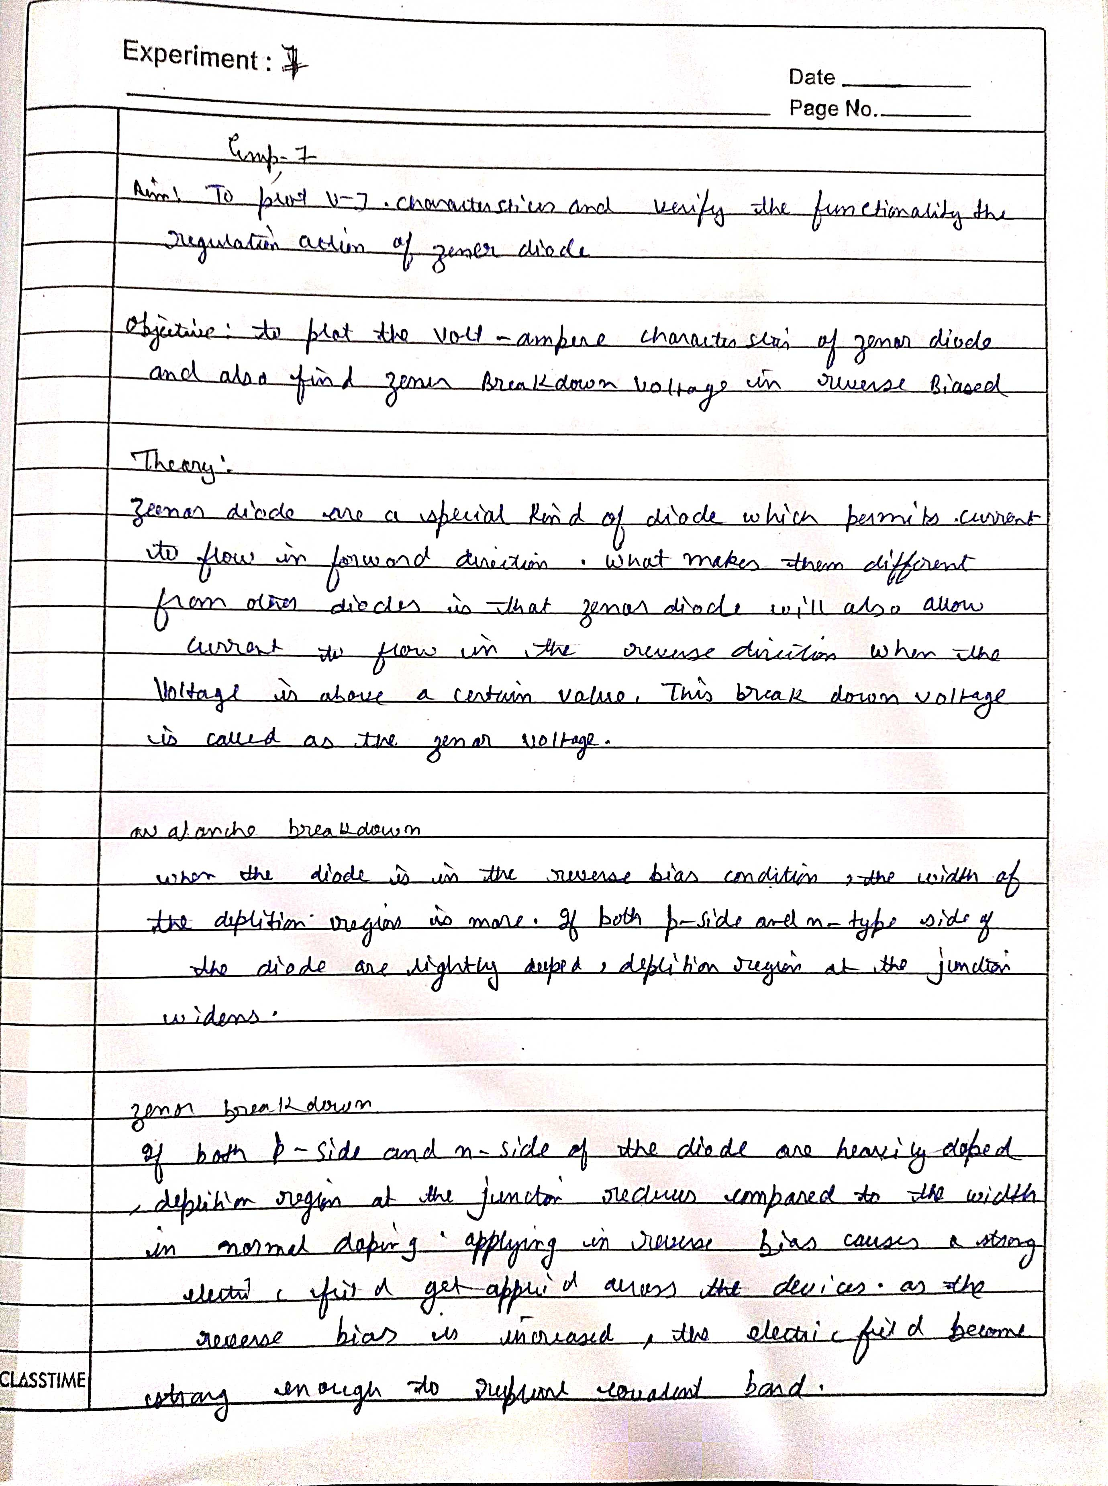
Neeraj singh p2 bee lab
Neeraj singh p2 bee lab

Slide 25
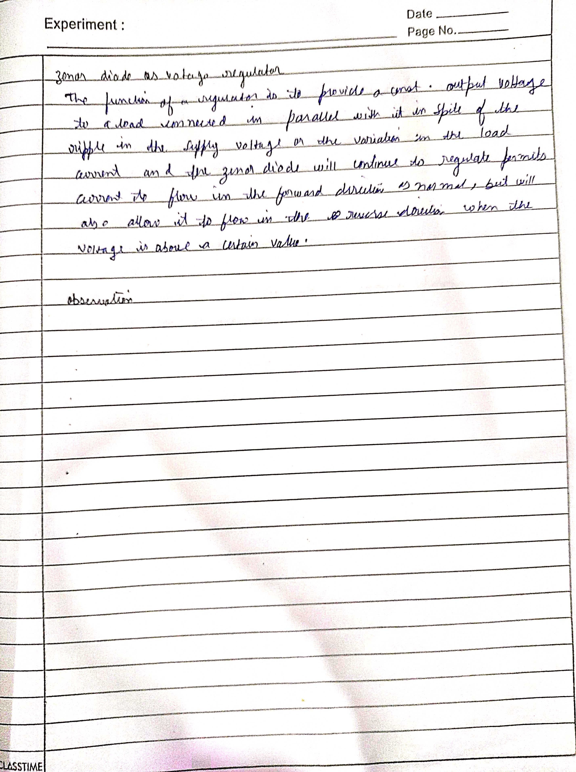
Neeraj singh p2 bee lab
Neeraj singh p2 bee lab

Slide 26
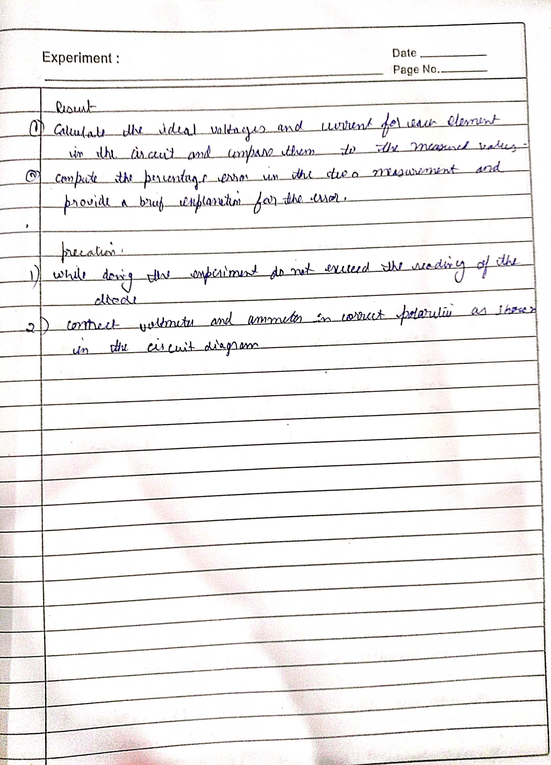
Neeraj singh p2 bee lab
Neeraj singh p2 bee lab

Slide 27
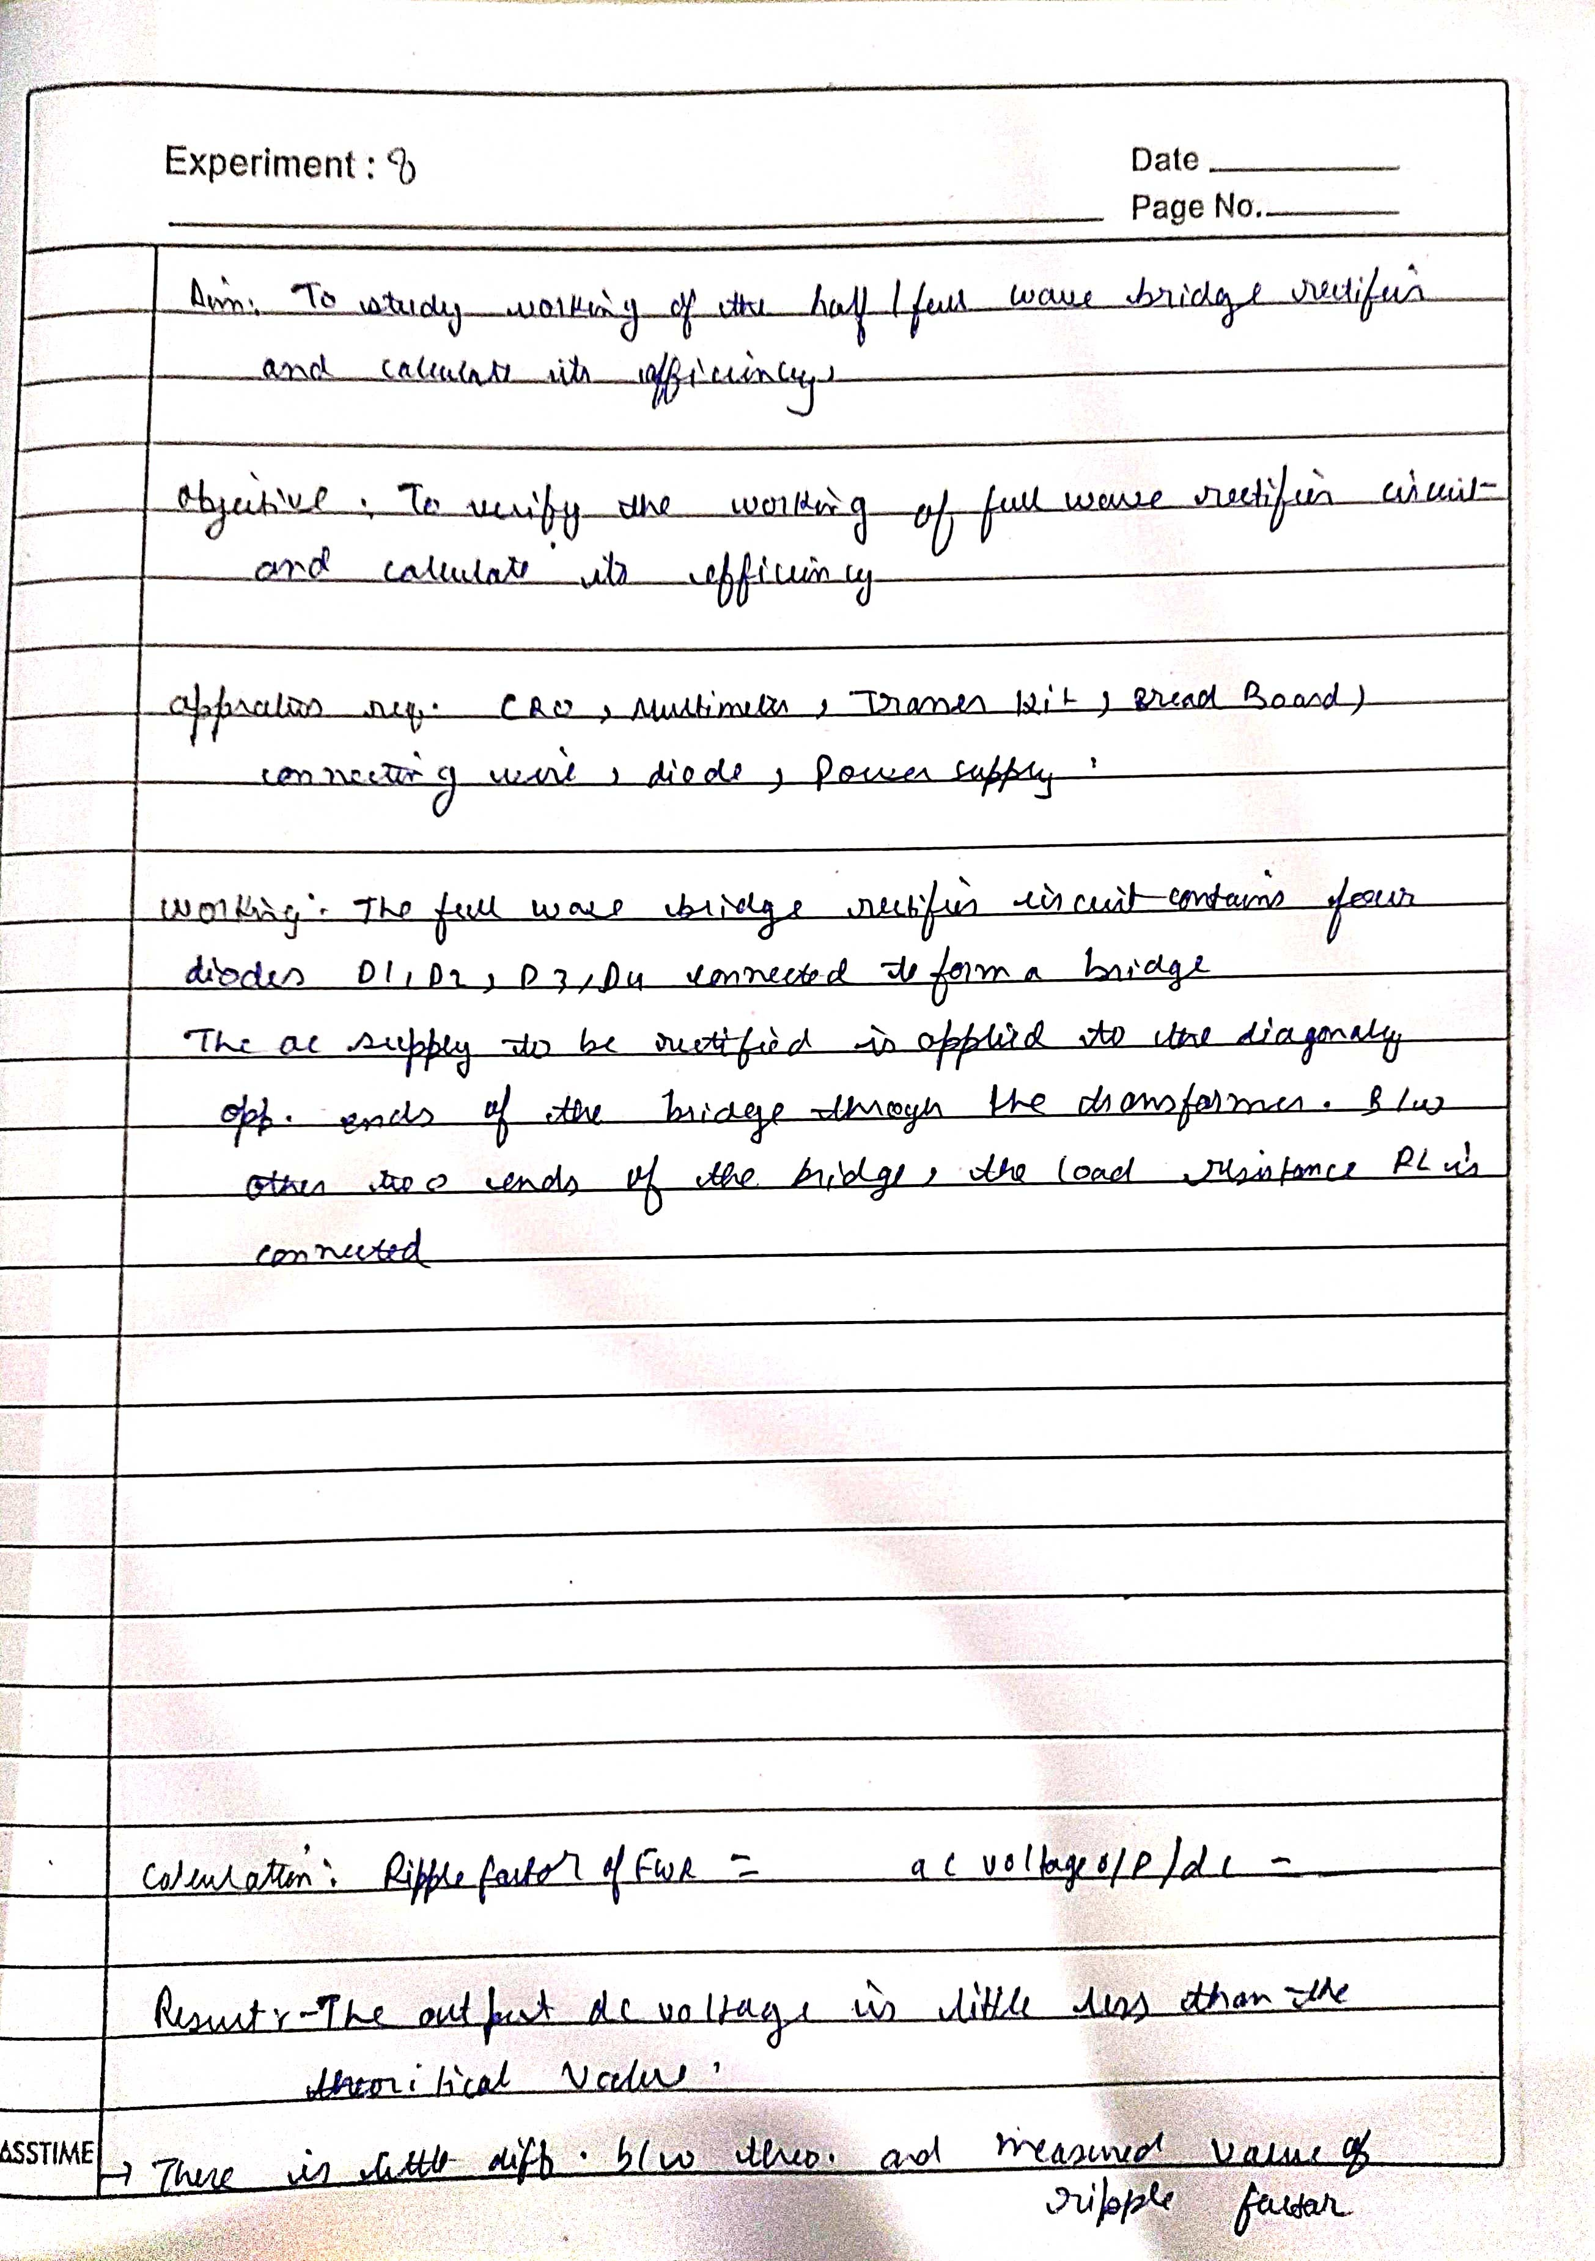
Neeraj singh p2 bee lab
Neeraj singh p2 bee lab

Slide 28
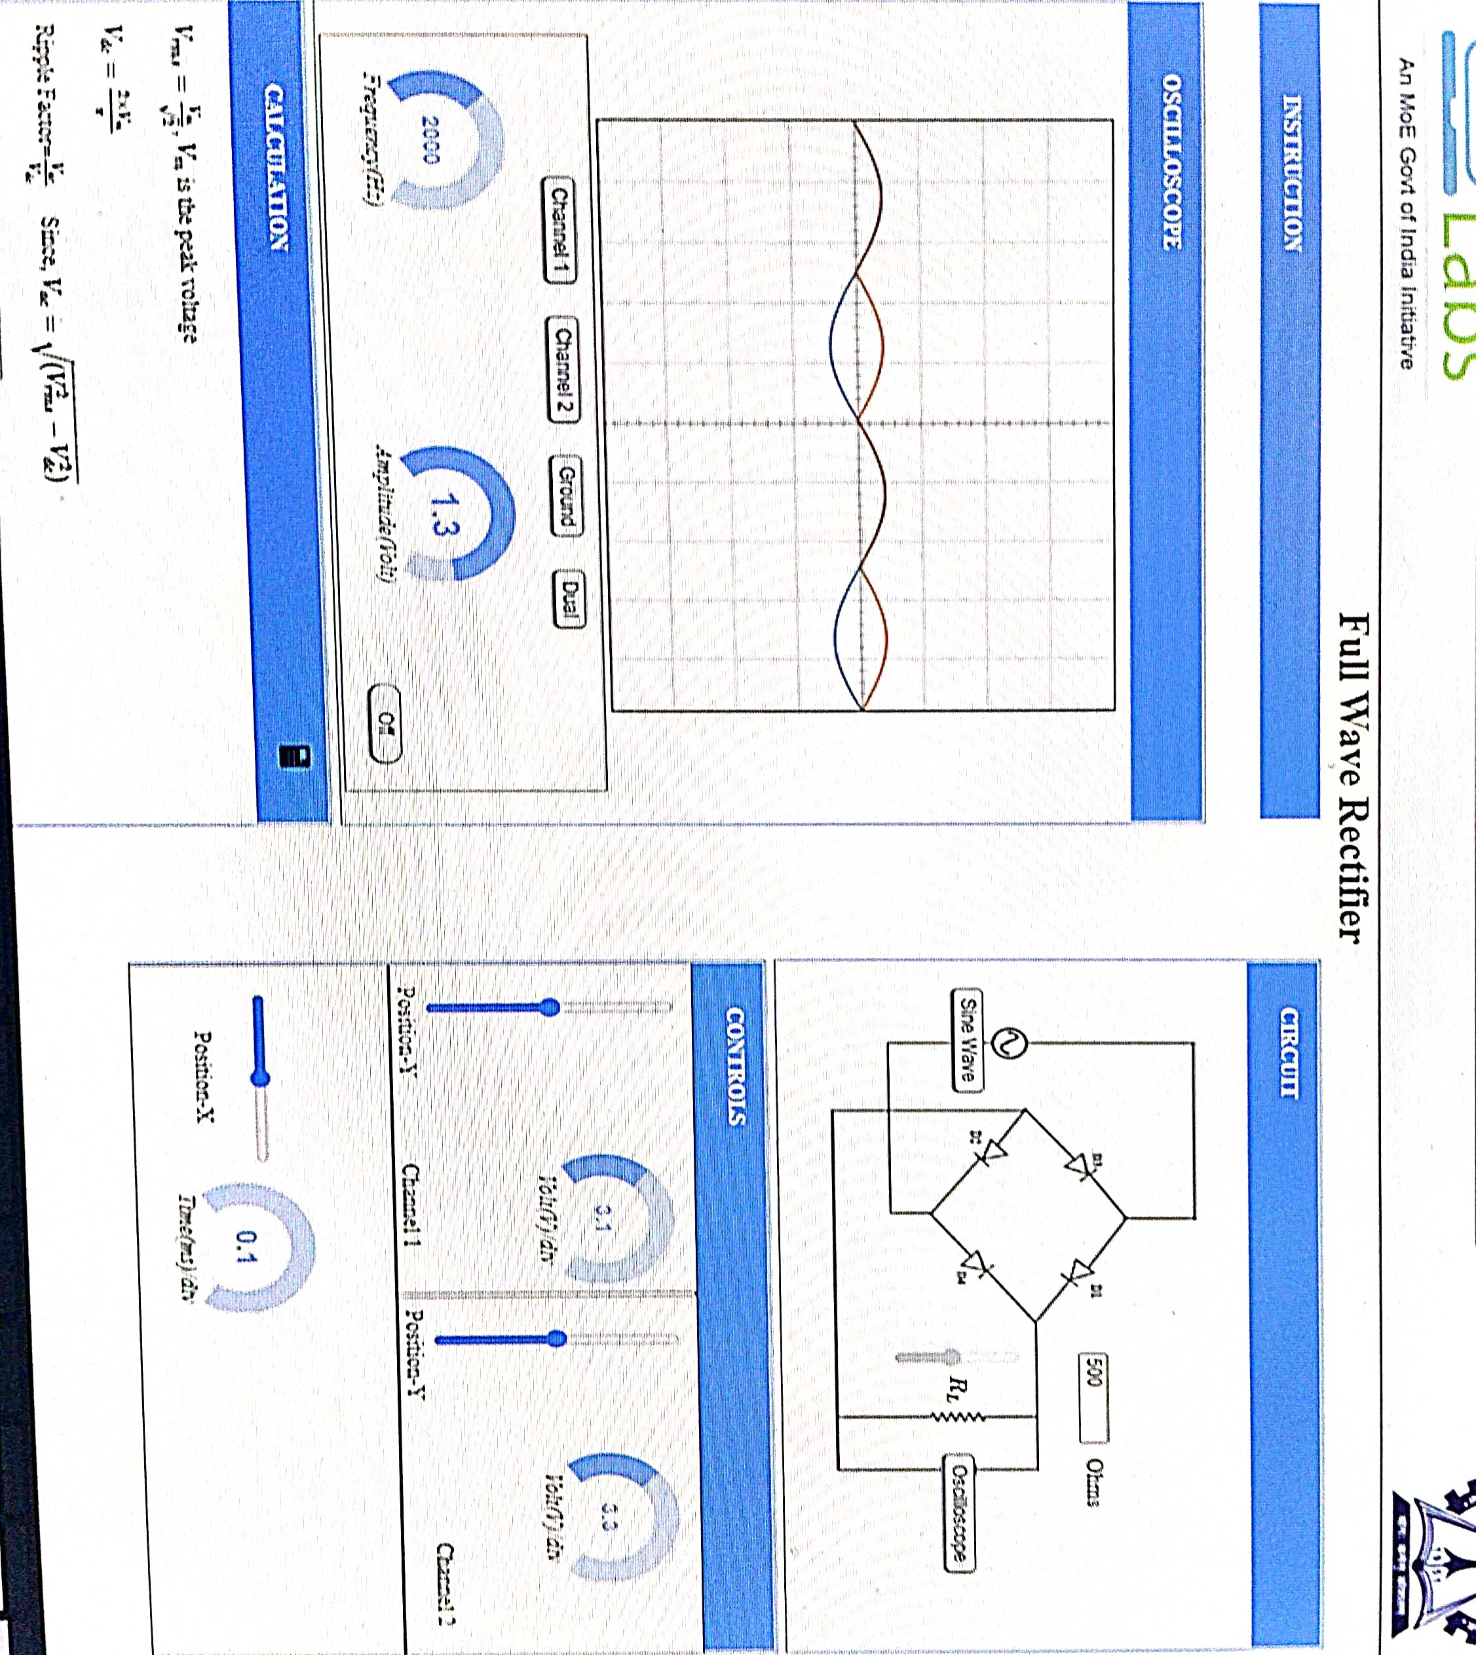
Neeraj singh p2 bee lab
Neeraj singh p2 bee lab

